Slide 1
The Globe
David Škrobánek SV2/P1

Slide 2
The Globe
The Globe Theatre was a theatre in London associated with William Shakespeare.
The Globe was destroyed by fire on 29 June 1613.
A second Globe Theatre was built on the same site by June 1614 and closed in 1642.
The Globe was built in 1599 using timber from an earlier theatre, The Theatre, which had been built by Richard Burbage's father, James Burbage, in Shoreditch in 1576

Slide 3
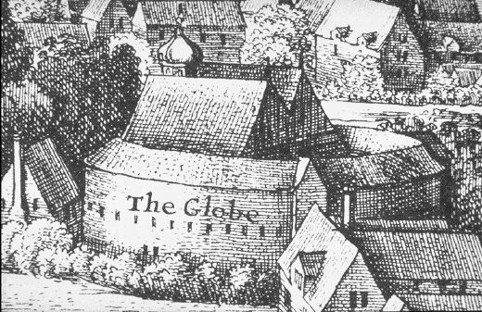
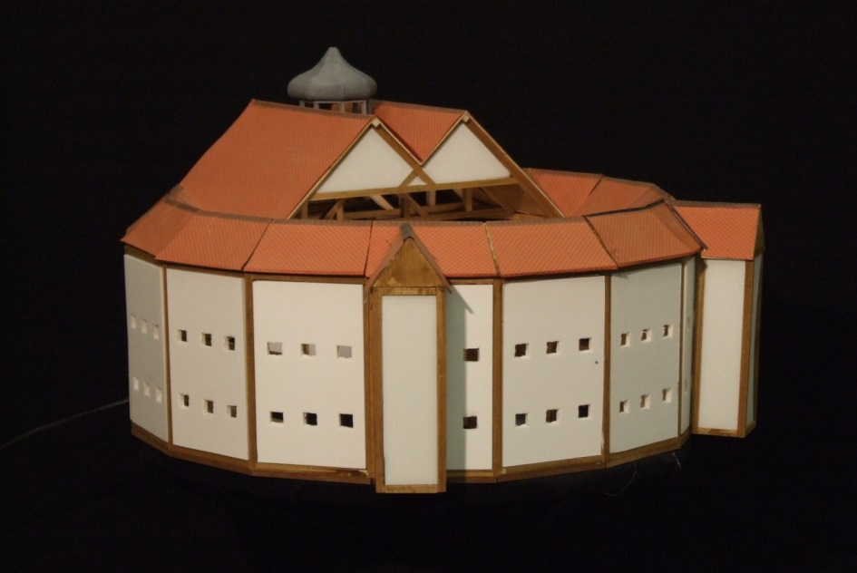
History
The Globe was built in 1599 using timber from an earlier theatre, The Theatre, which had been built by Richard Burbage's father, James Burbage, in Shoreditch in 1576.
The Globe was owned by actors who were also shareholders in Lord Chamberlain's Men

Slide 4
Destroyed by fire
On 29 June 1613 the Globe Theatre went up in flames during a performance of Henry VIII. A theatrical cannon, set off during the performance, misfired, igniting the wooden beams and thatching.
According to one of the few surviving documents of the event, no one was hurt except a man whose burning breeches were put out with a bottle of ale.
It was rebuilt in the following year.

Slide 5
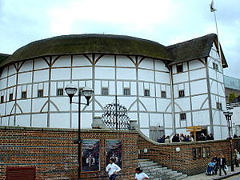
Shakespeare Globe
It‘s a modern reconstruction of the Globe, named "Shakespeare's Globe", opened in 1997 approximately (230 m) from the site of the original theatre.
In 1970, American actor and director Sam Wanamaker founded the Shakespeare Globe

Slide 6
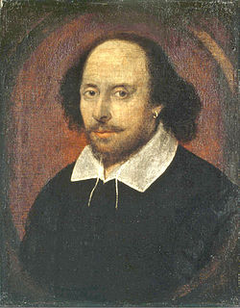
William Shakespeare
Shakespeare was an English poet, playwright and actor, widely regarded as the greatest writer in the English language.
Tragedies: Romeo and Juliet, Hamlet, Othello
Comedies: As You Like It, The Comedy of Errors

Slide 7
THE END

