Slide 1
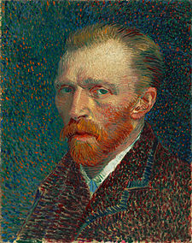
Vincent van Gogh
Born: march 30 - 1853
Died: july 29 - 1890

Slide 2
Life
Vincent was born to the protestant family. In 1857 was born his younger brother, and it was his who support Vincent for all life. He was realy interrested in religion. They failed him from many works. In 1880 vincent starts profesional painting. He loved his cousin but she didn‘t mind.
In 1886 he moved to Paris with his brother,where he discovered impressionism and pointilism.

Slide 3
After two years he didn‘t want to live with his brother anymore so he moved again this time to Arles in south France. There he invited Paul Gaugin to work here together. This frendship work for some time but then they quarreled (and some people said that they fight too and Gaugin cut Vincent‘s ear, but most of people said that Vincent did his on his own).
In 1889 he admint his psychical problems and went to clinic, but after one year he left. His depression was so bad that he shot himself to chest and… he died after TWO DAYS ! And it happend in front of his brother‘s eyes. His last words was: „La tristesse durera toujours.“ from french- „Sadness last forever“.

Slide 4
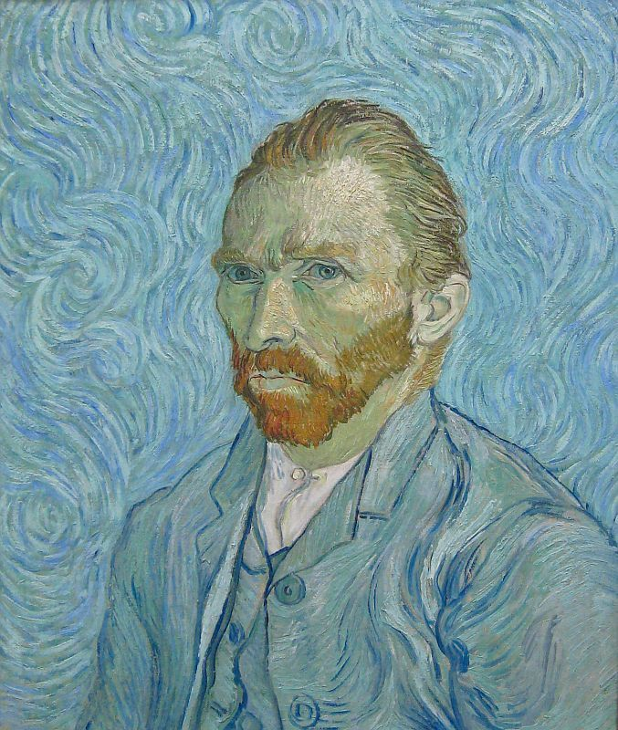
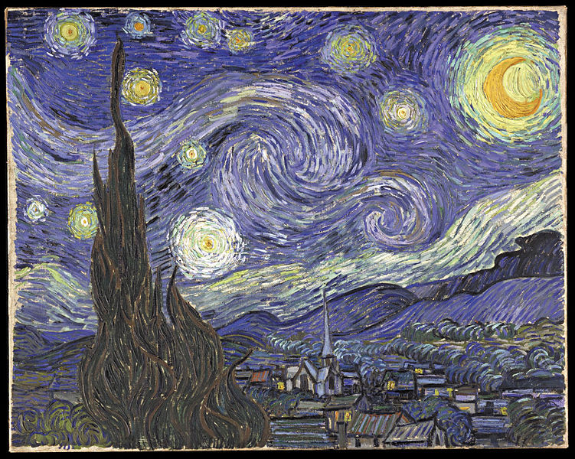
Most Epic Paintings
Star‘s Sky
Autoportrait

Slide 5
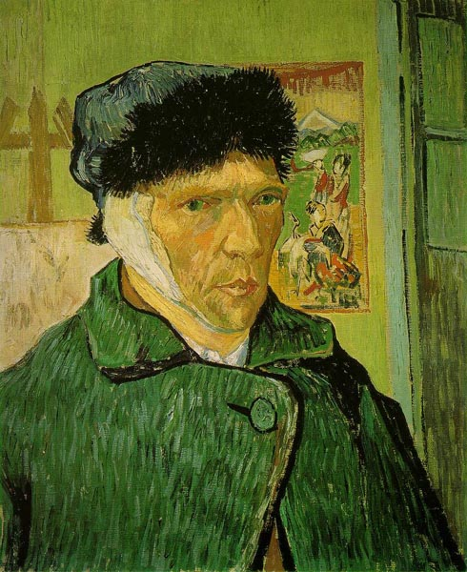
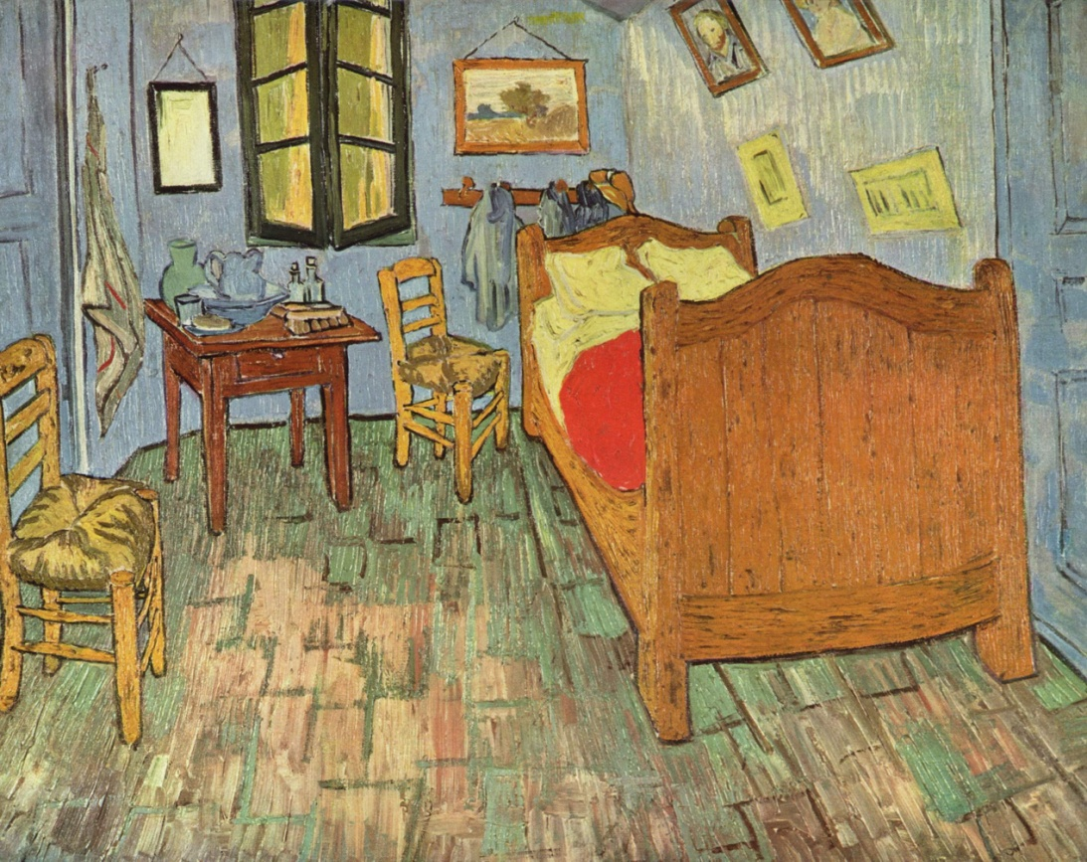
Most Epic Paintings 2
My room
No ear bro!

