Slide 1
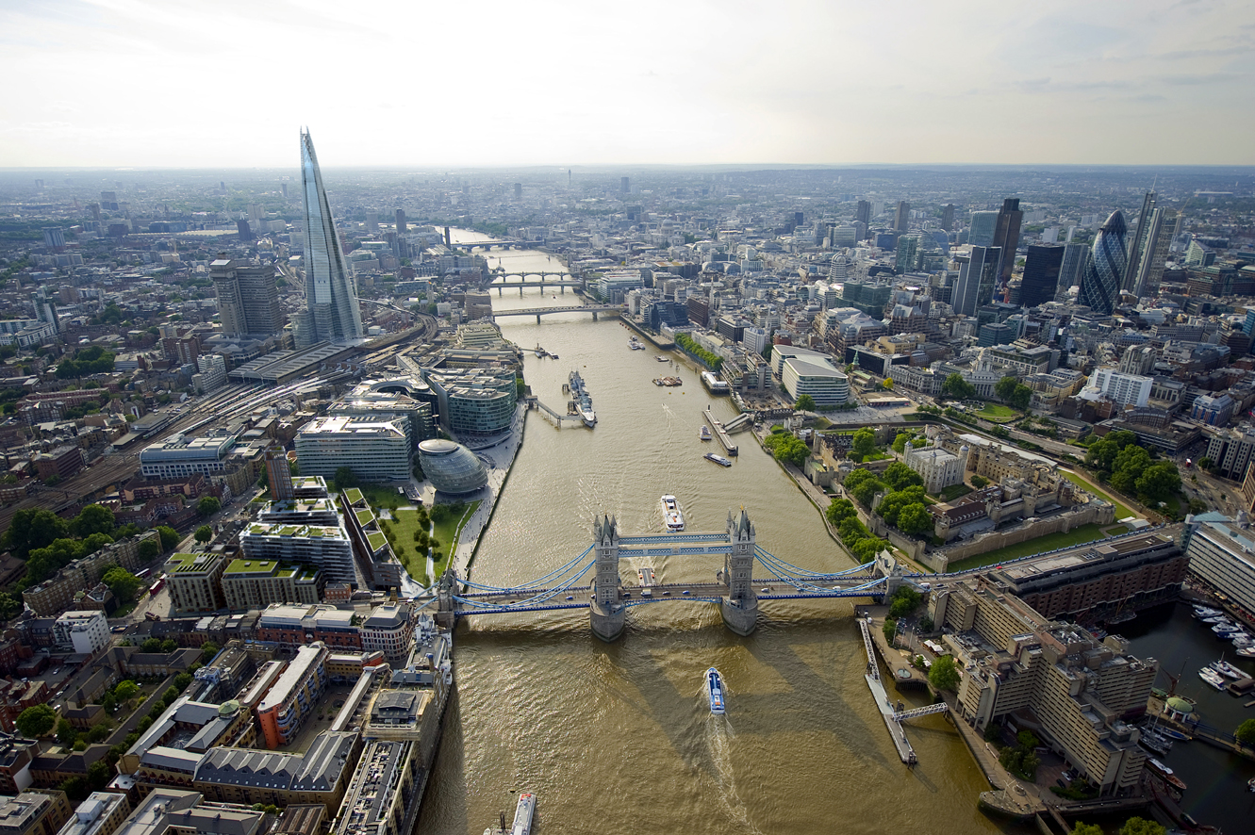
Tower bridge and the Tower

Slide 2
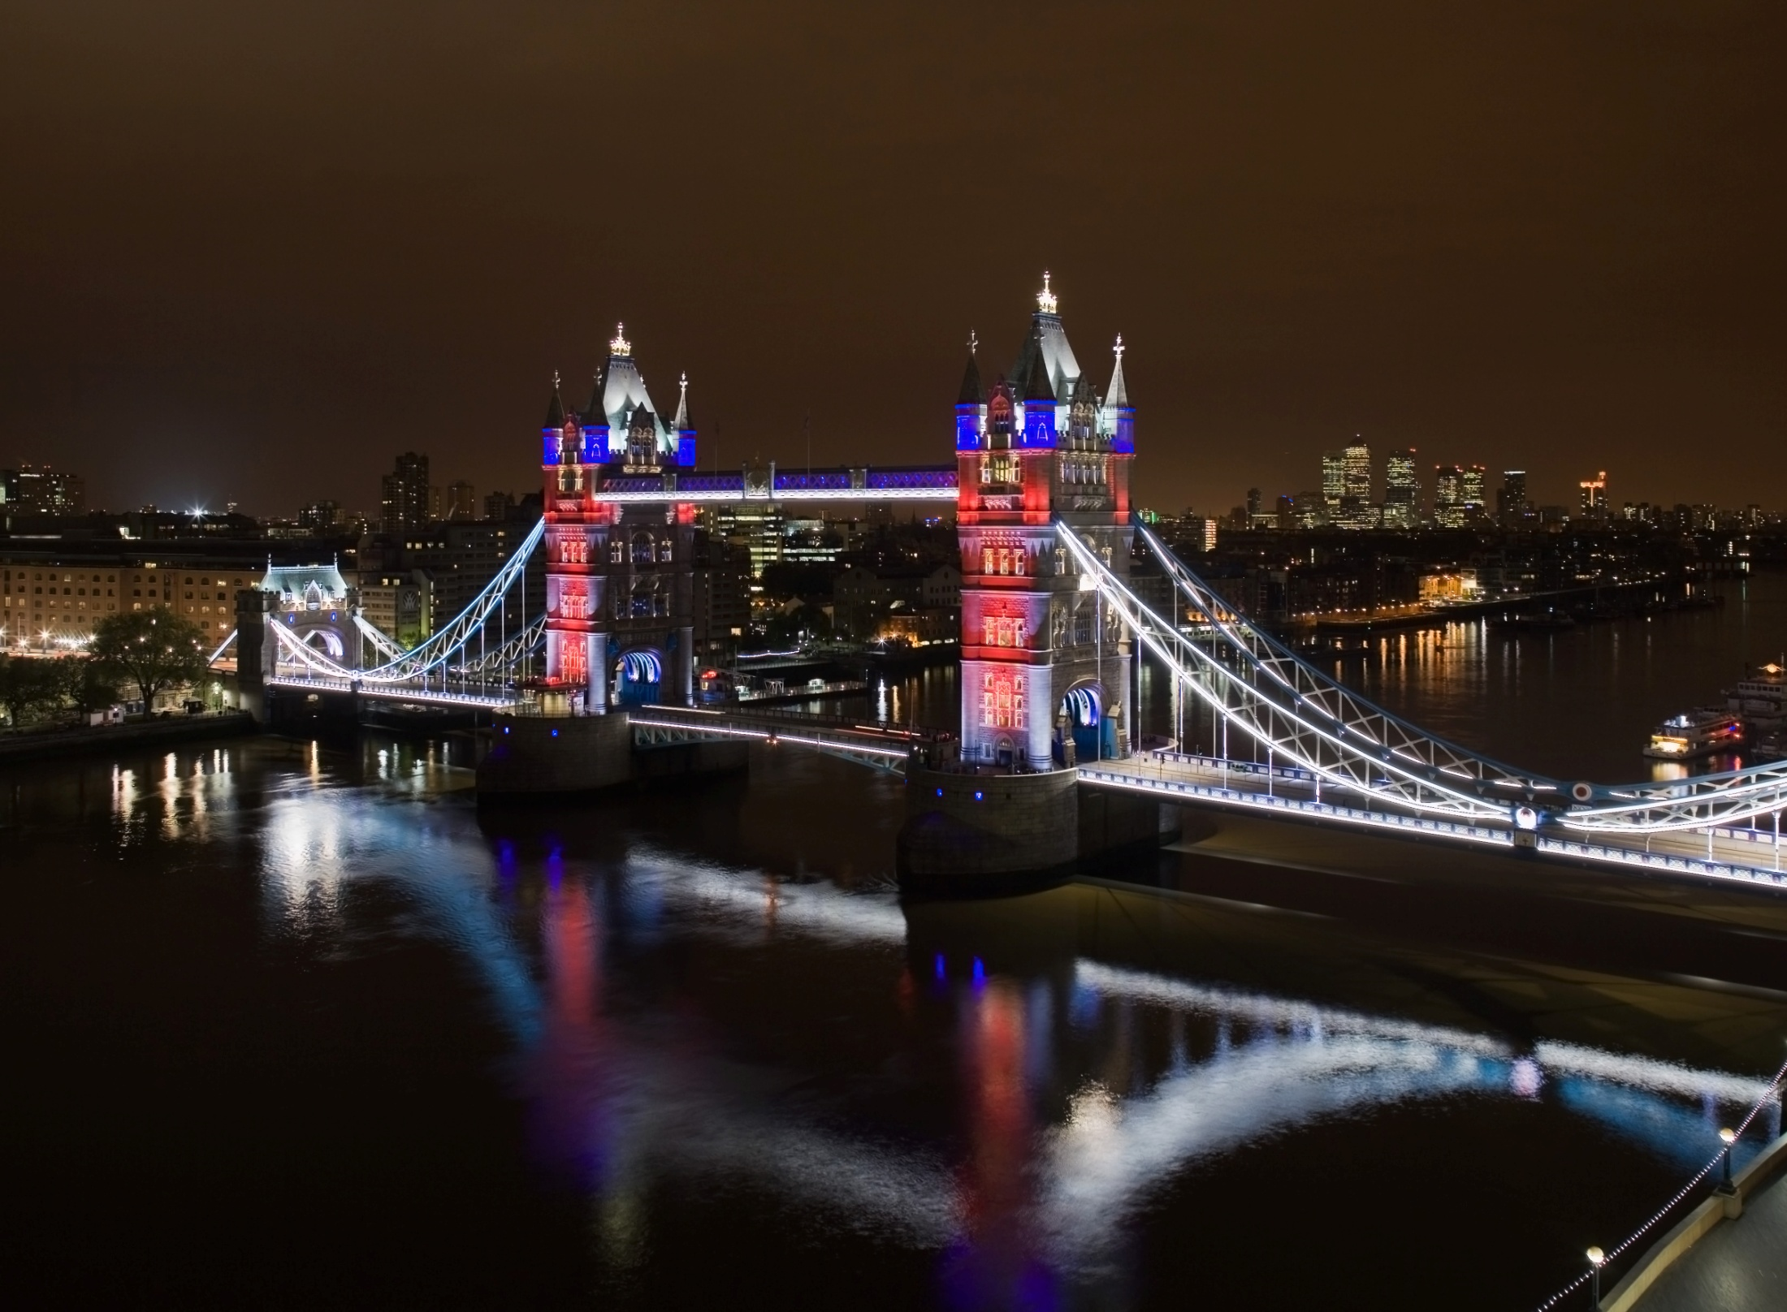
The Tower bridge
Tower Bridge is a bridge in London. It crosses the River Thames near the Tower of London. The north side of the bridge is Tower Hill, and the south side of the bridge comes down into Bermondsey - area in Southwark. It is far more visible than London Bridge, which people often mistake it for. If large boats need to sail under Tower Bridge, the two halves of the bridge lift up to let it under. Many tourists go to London see the Tower Bridge.

Slide 3
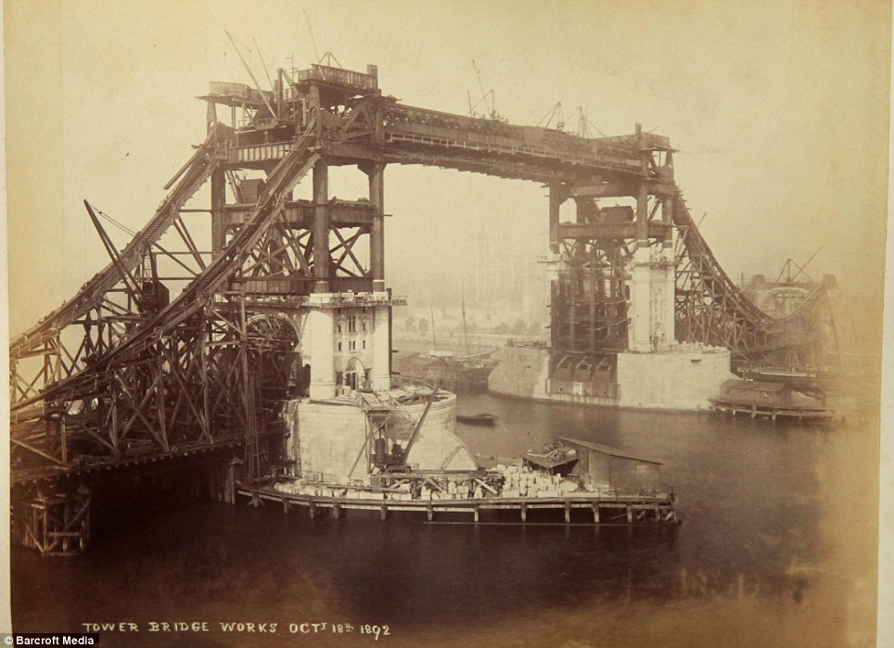
History
The City of London Corporation declared a competition about design of Tower Bridge.
Between 50 designs won Horace Jones and John Wolfe Barry's design in 1884.
Workers began to build the Tower Bridge in April 1886 and the bridge was opened in 30th June 1894.

Slide 4
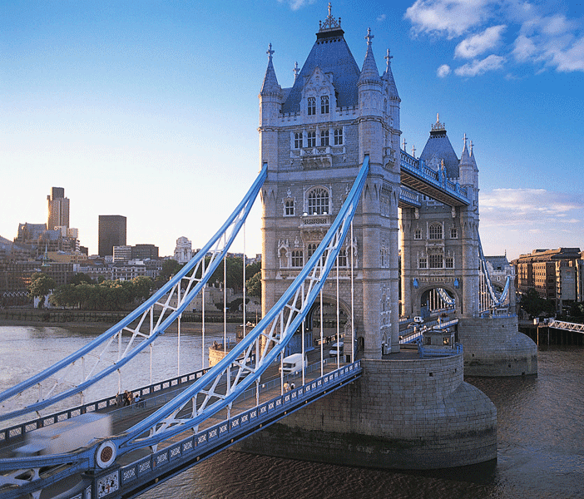
Design
The bridge is built on piers, it has 244 m with two towers, each 65 m high. The bridge is made from more than 11,000 tons of steel, and covered with Cornish granite and Portland stone.

Slide 5
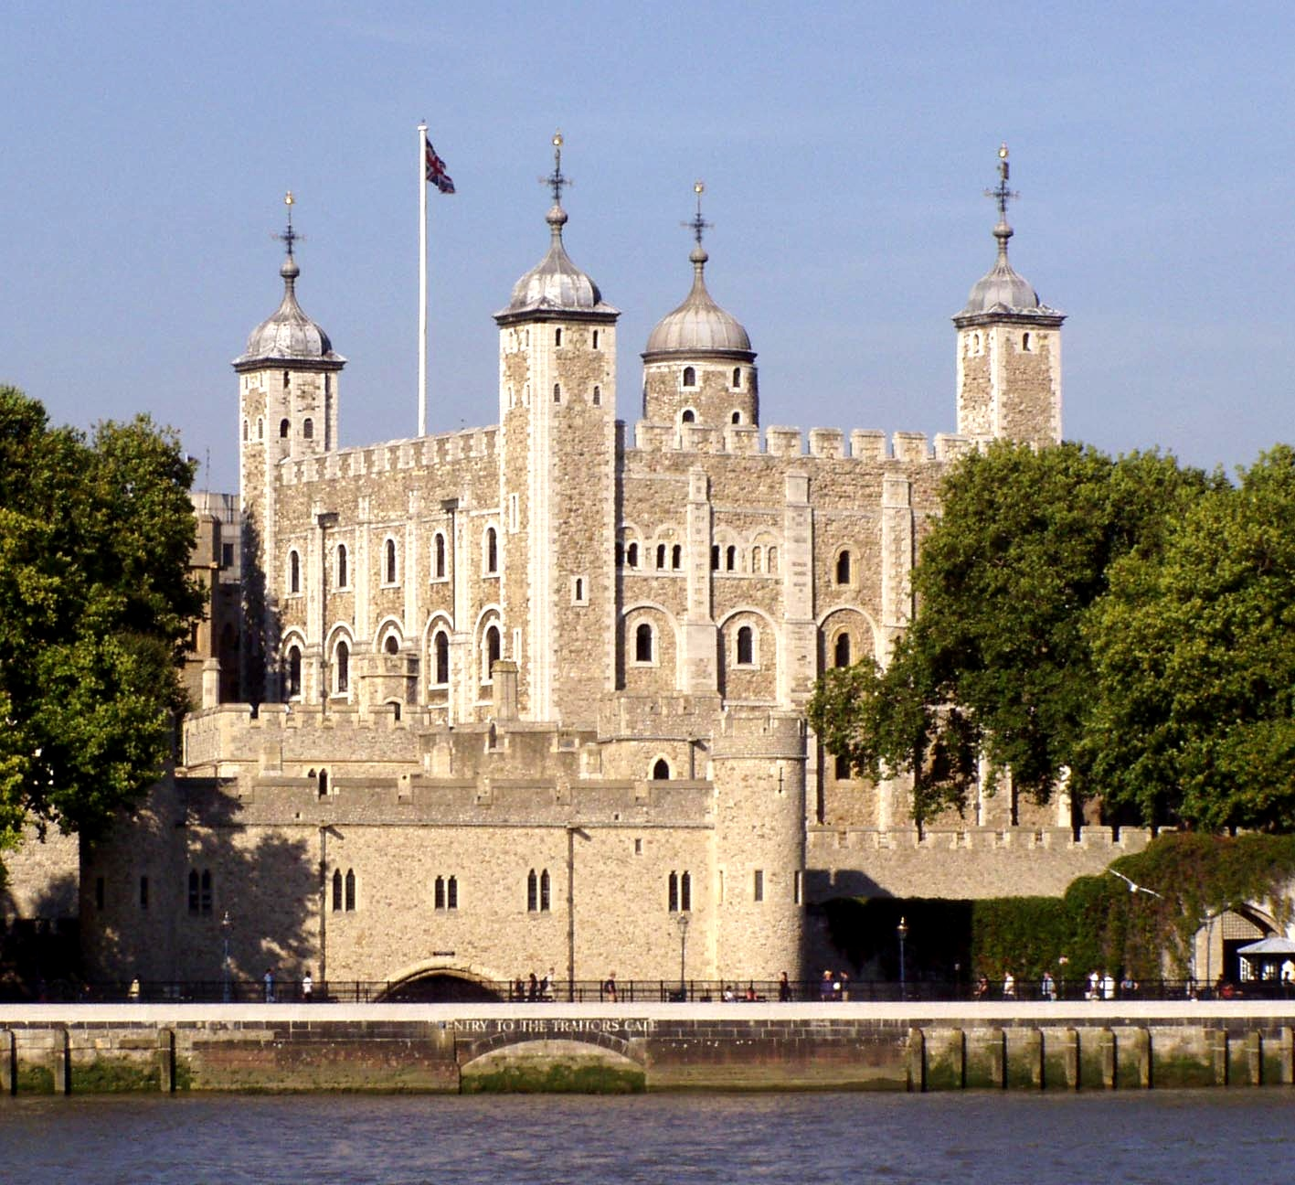
The Tower of London
is an ancient Norman stone fortress
in London, England. It stands on the bank of the River Thames, in the oldest part of the city.
It is in UNESCO.

Slide 6
History
The fortress was built by William the Conqueror, King William I, starting in 1078. The moat was built by Richard I, using water diverted from the River Thames.
The Tower had many uses. Its main function was to protect Norman rule in the years after the conquest (capture). It was a prison, and a place of execution. Today, the Crown Jewels are kept there. This is the collection of jewels owned by the British state, and sometimes worn by the monarch. There is also a museum of armour.

Slide 7
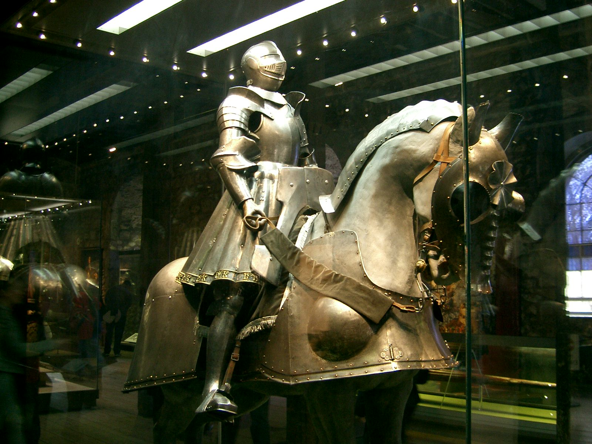
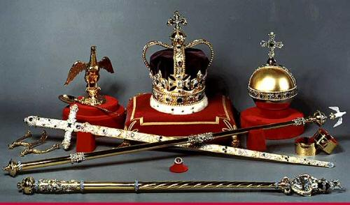
Legend

Slide 8
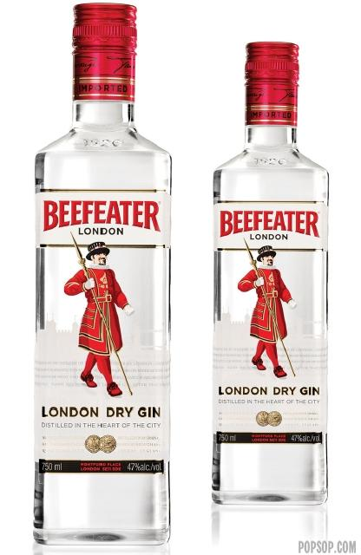
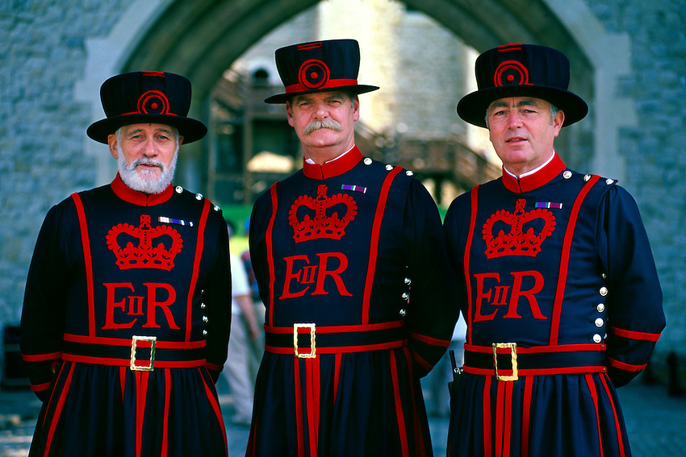
The guards
Beefeaters, are ceremonial guardians of the Tower of London. In principle they are responsible for looking after any prisoners in the Tower and safeguarding the British crown jewels, but in practice they carry the turists.

Slide 9
Thank you for your attention

