Slide 1
London´s parks
In London is eight royal parks – Hyde Park, Green Park, St. James´s Park, Greenwich Park, Regent´s Park, Kensington Gardens, Richmond Park and Bushy Park, but in real in London is about 1700 parks. All parks take up 11% area of London.

Slide 2
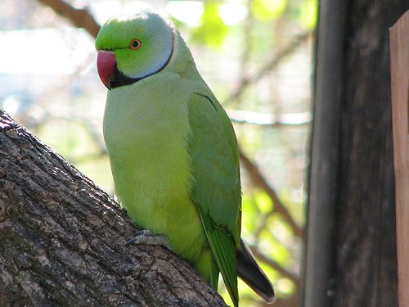
In London parks are usual parrots but this parrots aren´t from England. They are from Asia but we can see them everywhere in London.

Slide 3
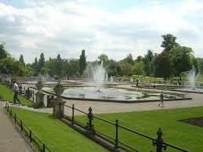
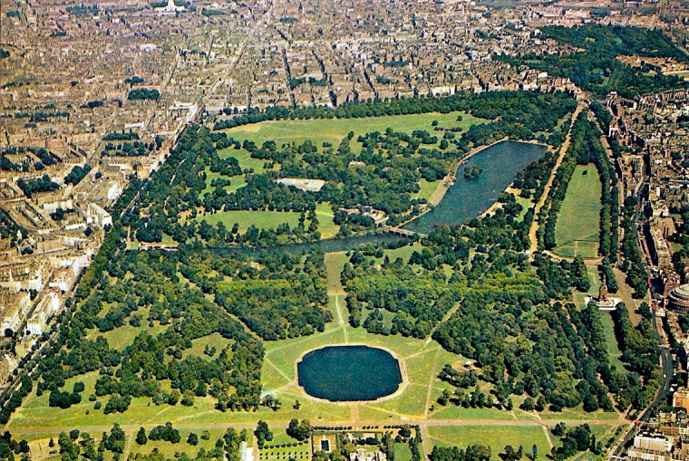
One of the biggest royal parks is Hyde Park. There is monument of princes Diana from Wales. In the middle of park is long lake.

Slide 4
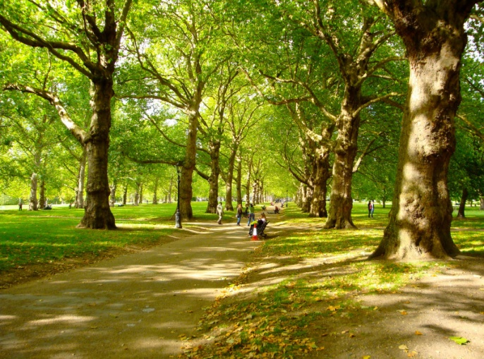
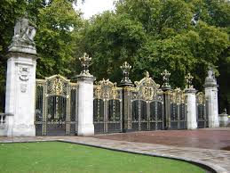
Green Park is very near Buckingham palace. This park is the smallest of royal London´s park. In the fifteenth century it was swampy graveyard for people from near hospital Saint James's.

Slide 5
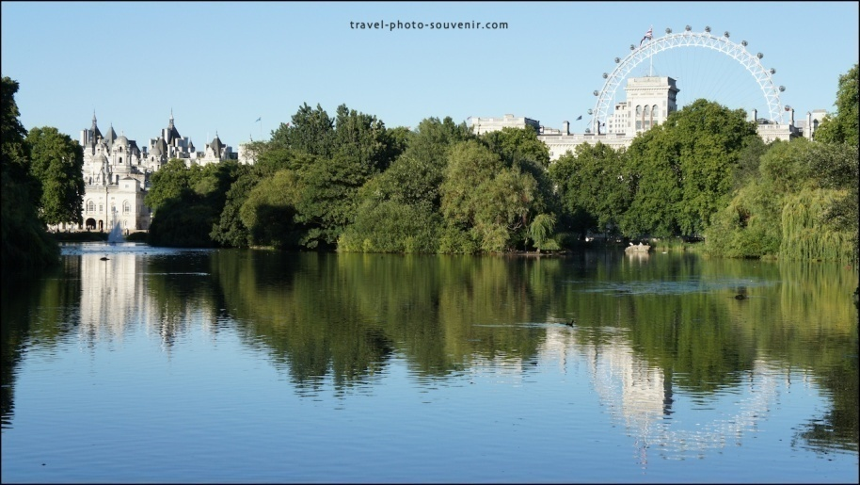
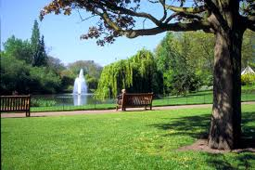
In the St. James´s Park is small lake with two islands Duck Island and West Island. From bridge between these islands we can see Buckingham Palace.

Slide 6
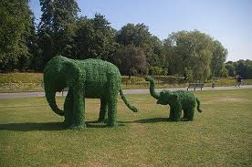
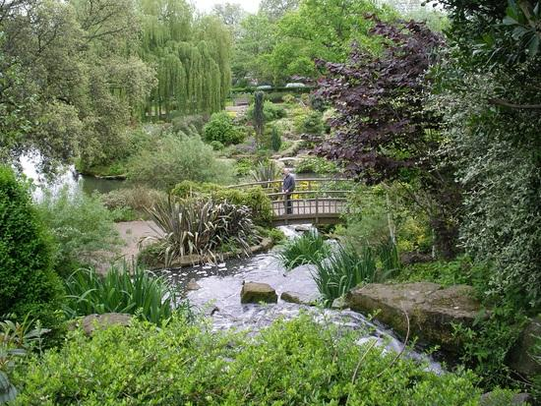
In the northeastern part of the Regent´s Park is London zoo. This park is formed of fields, gardens and one lake with waterfall. It´s the biggest park in London and all Europe.

Slide 7
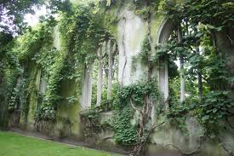
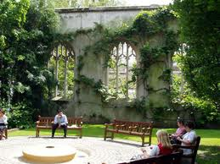
One of very unusual and magic place in London is garden in ruined church St. Dunstan-in-the-East. This church was ruined in Second World War and the ruins are now a public garden.

