Slide 1
Royal family
History and present
Author: Dan Schöberle
Class: SV1/p1

Slide 2
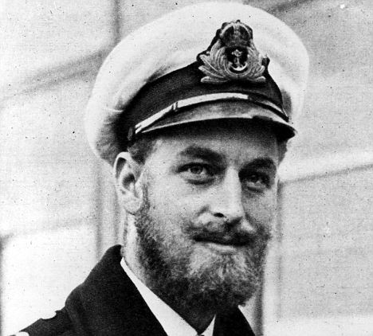
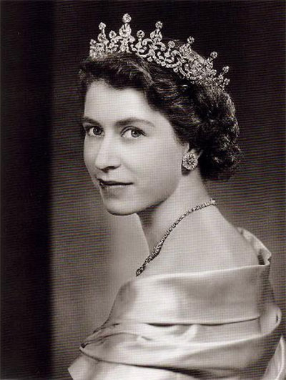
History of monarchy
On 30 November 1917, King George V issued Letters Patent defining the styles and titles of members of the Royal Family
In 1996, Her Majesty The Queen modified these Letters Patent
On 31 December 2012, Letters Patent were issued to extend a title and a style borne by members of the Royal Family to additional persons to be born

Slide 3
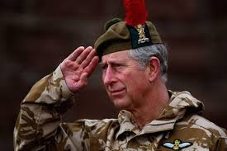
Charles Philip Arthur George
Charles, Prince of Wales
First grandchild of King George VI and Queen Elizabeth
In 1981, he married Lady Diana Spencer and they had two sons, Prince William, and Prince Harry
In 1996, the couple divorced, following well-publicised extra-marital affairs

Slide 4
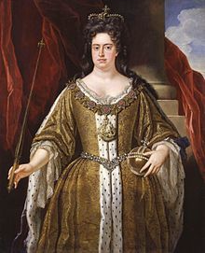
Queen Anne
Became Queen of England, Scotland and Ireland on 8 March 1702
Anne was unable to walk between January and July 1713
Titles and styles
6 February 1665 – 28 July 1683: Her Highness The Lady Anne
28 July 1683 – 8 March 1702: Her Royal Highness The Princess Anne of Denmark[216]
8 March 1702 – 1 August 1714: Her Majesty The Queen

Slide 5
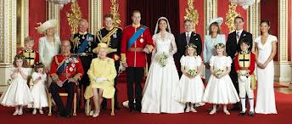
Present
This is a list of current members of the Royal Family who bear the style of Majesty:
HM The Queen and HRH The Duke of Edinburgh (The Queen's husband)
TRH The Prince of Wales and The Duchess of Cornwall[5] (The Queen's eldest son and his second wife)
HRH The Duke of York (The Queen's second son)
HRH The Princess Royal (The Queen's daughter)

Slide 6
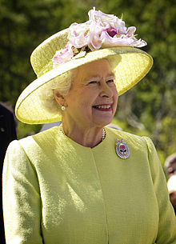
British queen Elizabeth II.
Born 21 April 1926
Upon her accession on 6 February 1952, Elizabeth became Head of the Commonwealth and queen regnant of seven independent
Queen of this countries:
United Kingdom, Canada, Australia, New Zealand, South Africa, Pakistan and Ceylon
In 1947, she married Prince Philip of Greece and Denmark, with whom she has four children: Charles, Anne, Andrew, and Edward

Slide 7
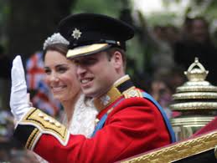
William Arthur Philip Louis
Father is Charles, Prince of Wales
Mother is Diana, Princess of Wales
Prince William married Catherine Middleton
Their first child, Prince George of Cambridge, was born on 22 July 2013
Prince William was educated at four schools in the United Kingdom and obtained a degree from the University of St Andrews
Prince William has also taken Kiswahili studies at universities in Kenya and Tanzania

Slide 8
This is the end
Thank you for your attention

