Slide 1
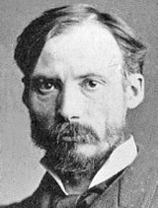
Pierre-Auguste Renoir
Born – 25 February 1841 Died – 3 December 1919

Slide 2
French artist who was a leading painter in the development of the Impressionist style.

Slide 3
Renoir’s painting was always beautiful and optimistic. Renoir's paintings are probably the most popular, well-known, and frequently reproduced images in the history of art.

Slide 4
His father is tailor.

Slide 5
When he was 6 years old they moved to paris.

Slide 6
He realy like music but Renoir destiny was painting.

Slide 7
When he was 13 he went to porcelain school, here was decorated porcelain in the style of the 18th century.

Slide 8
In 1862, Renoir began to study at the École des Beaux-Arts and attend Gleyrov studio, there he met Sisley and Monet. He studied drawing in his free time.

Slide 9
He painted portraits, and still life, but above all, he painted social scenes of the day.

Slide 10
He was the father of actor Pierre Renoir (actor) , filmmaker Jean Renoir and ceramic artist Claude Renoir.
And grandfather of Claude Renoir, son Pierre

Slide 11
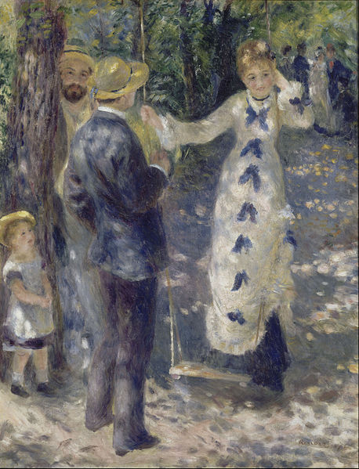
The swing oil on canvas

Slide 12
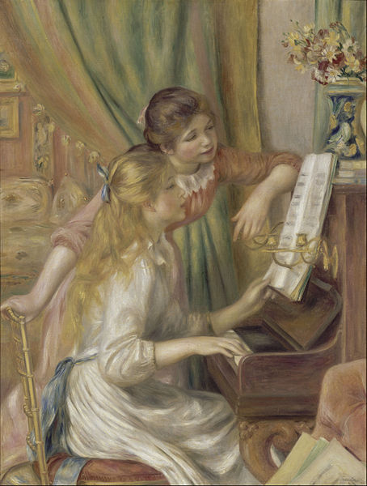
Young girls at
the piano 1892

Slide 13
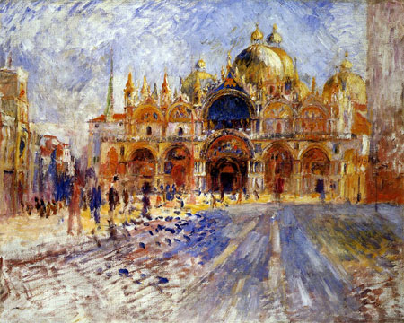
Pizza San
Marco

