Slide 1
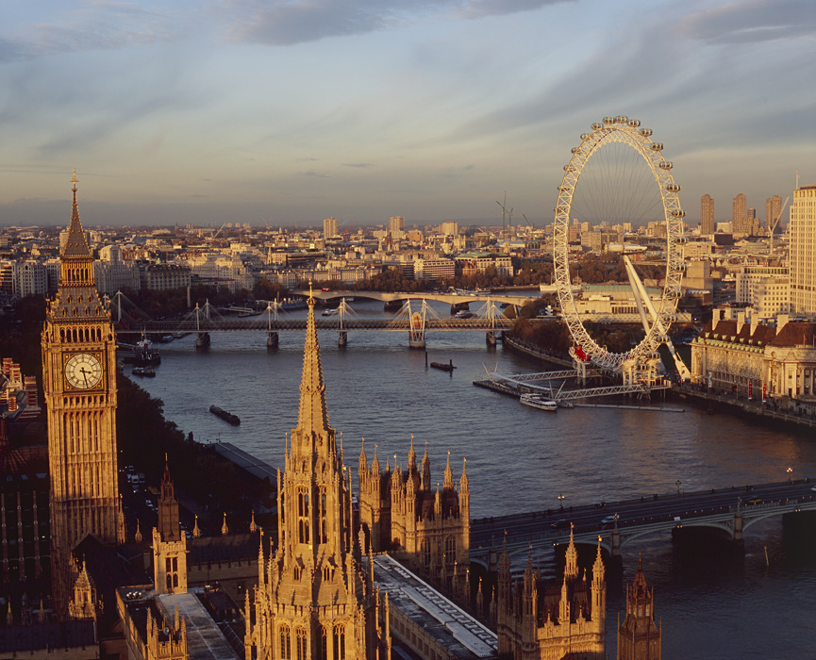
London

Slide 2
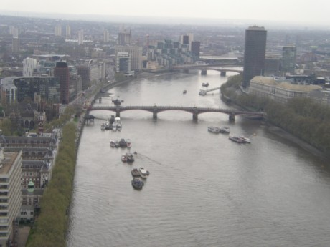
Location
London is located in England.
Accurately on the southeast shore of the river thames.
But normaly called London is a collection of cities.
And the heart of the London is City of London
Flag of England
River Thames

Slide 3
Population
London have large amount of people. In 2012 it was 8 308 369 people. This contains 12,5% of the UK population.
And over 300 languages is spoken in London.
Religion in london – Christians 48,4%, no religion 20,7%, Muslims 12,4%, no response 8,5%, Hindus 5%, Jews 1,8%, Sikhs 1,5%, Budhists 1% and other 0,6%
Ethnic groups – White 59,7%, Asian 18,4%, Black 13,3% and Mixed 5%

Slide 5
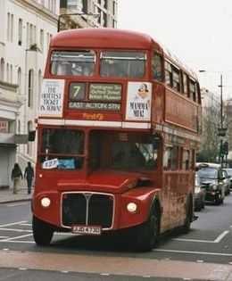
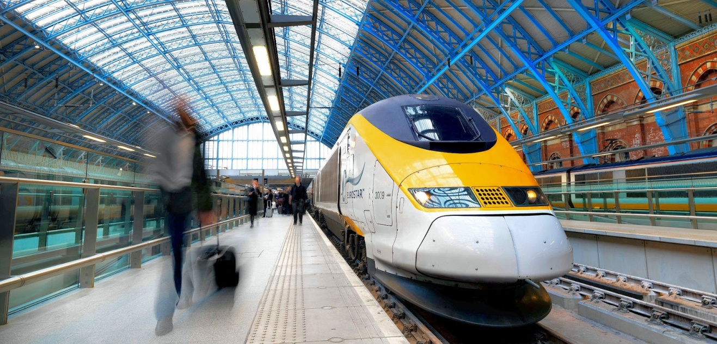
Transport
So you can get to the London by train or in plane or or even by boat.
And there are more and more transport ways. Like you can get there by bus or in the airship.
There is enough ways how to get there. So you don‘t have to worry if you missed plane or ship.
Typical London bus

