Slide 1
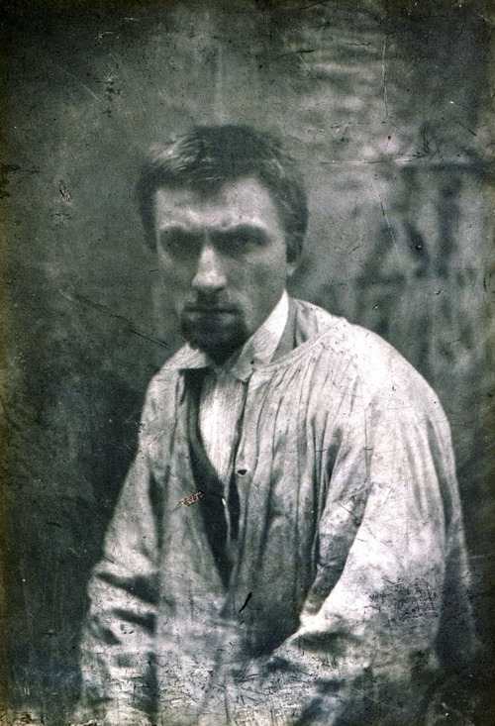
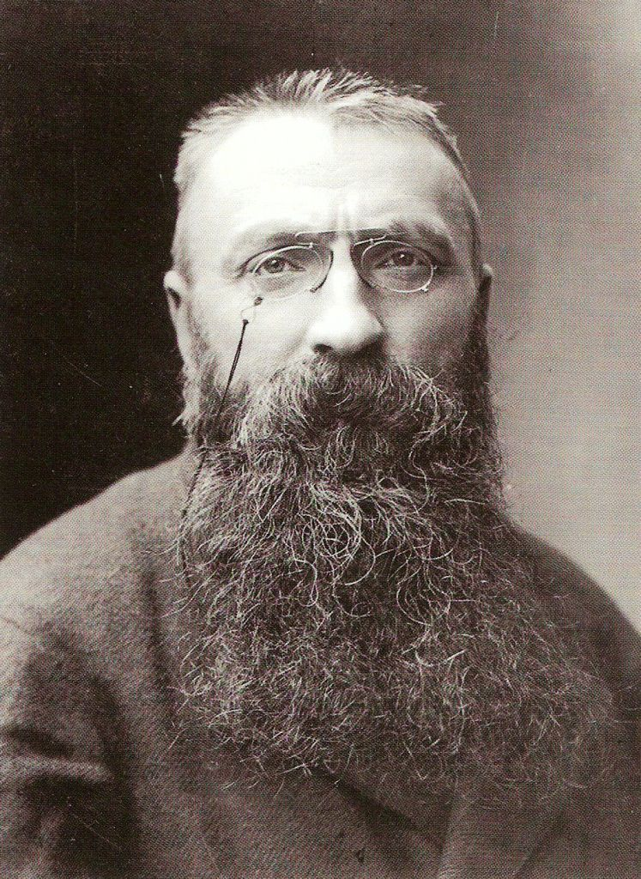
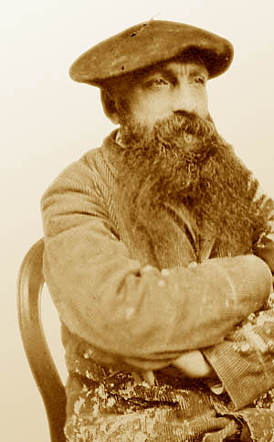
Auguste Rodin
François-Auguste-René Rodin

Slide 2
Life
French sculptor born on 12th November in 1840 in Paris
When he was 11 years old – sent to Beauvais (to his uncle)
At the age of 14 – Petite École school (design and art)
Wanted to study on art school like a sculptor (refused)
In these times – very depressed and in 1862 died his sister Marie
He made small decor statues and his own works
He decided to finish with art and entered to catholic monastery (convinced to continue in art)

Slide 3
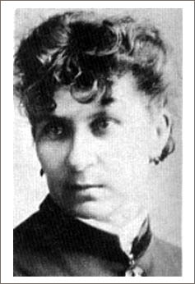
Wanted an exhibition in Salon in 1863 (refused, aslo in
1864 – 1865)
He started to live with Rose Beuret (dressmaker)
– they had son Auguste – Eugène Beuret
Fist exhibition – 1864
Employed in an atelier, making of small statues
Franco – Prussian War broke out and he was called (released for his short – sightness
He left to Brussels, later to Italy (finding out Michelangelo‘s works)

Slide 4
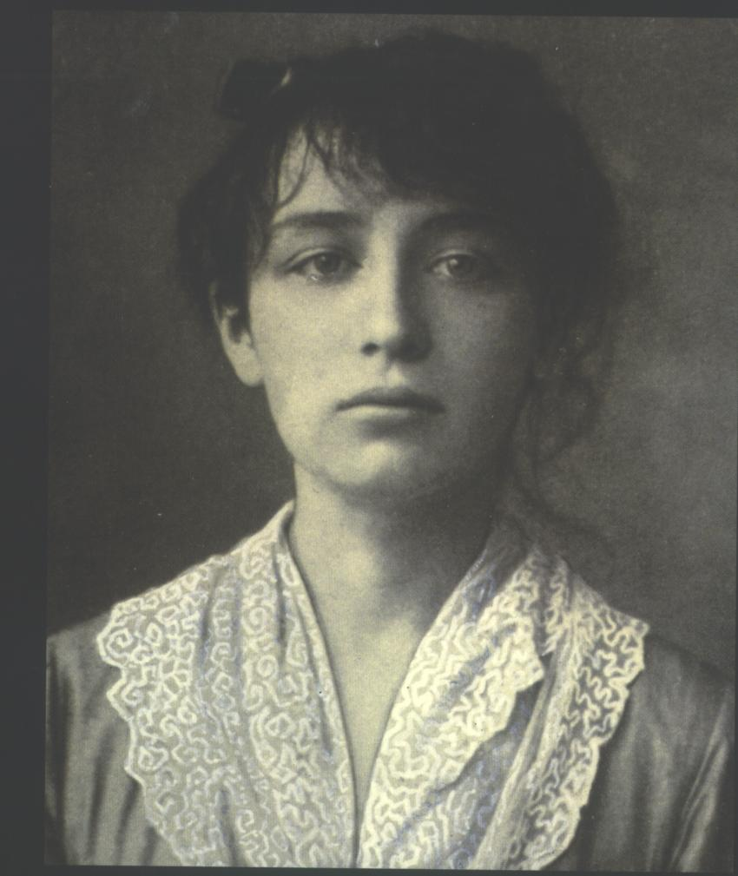
In 1877 – a return to Paris (his mother died and
father was senile and blind)
He had many lovers – one of these was
Camille Claudel (18 years)
After 1900 Rodin‘s fame only grew – invited to a jury of Salon
After 53 years he married Rose Beuret (she died two weeks later)
Rodin died on 17th November in 1917 in Meudon and burried on 24th November next to his wife (in Meudon)
On their grave – statue of „The Thinker“

Slide 5
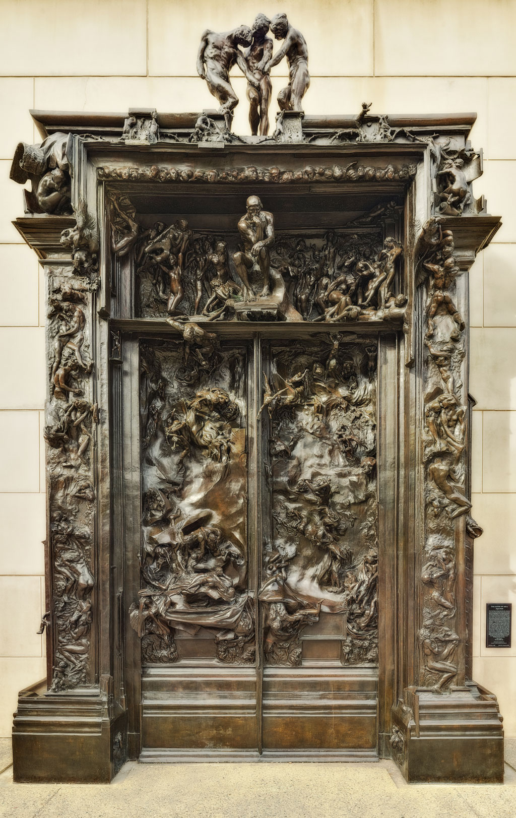
His Works
The Gates of Hell
He worked on it almost 40 years
and he never finished this
Scenes of „Divine Comedy“ from Dante Alighieri

Slide 6
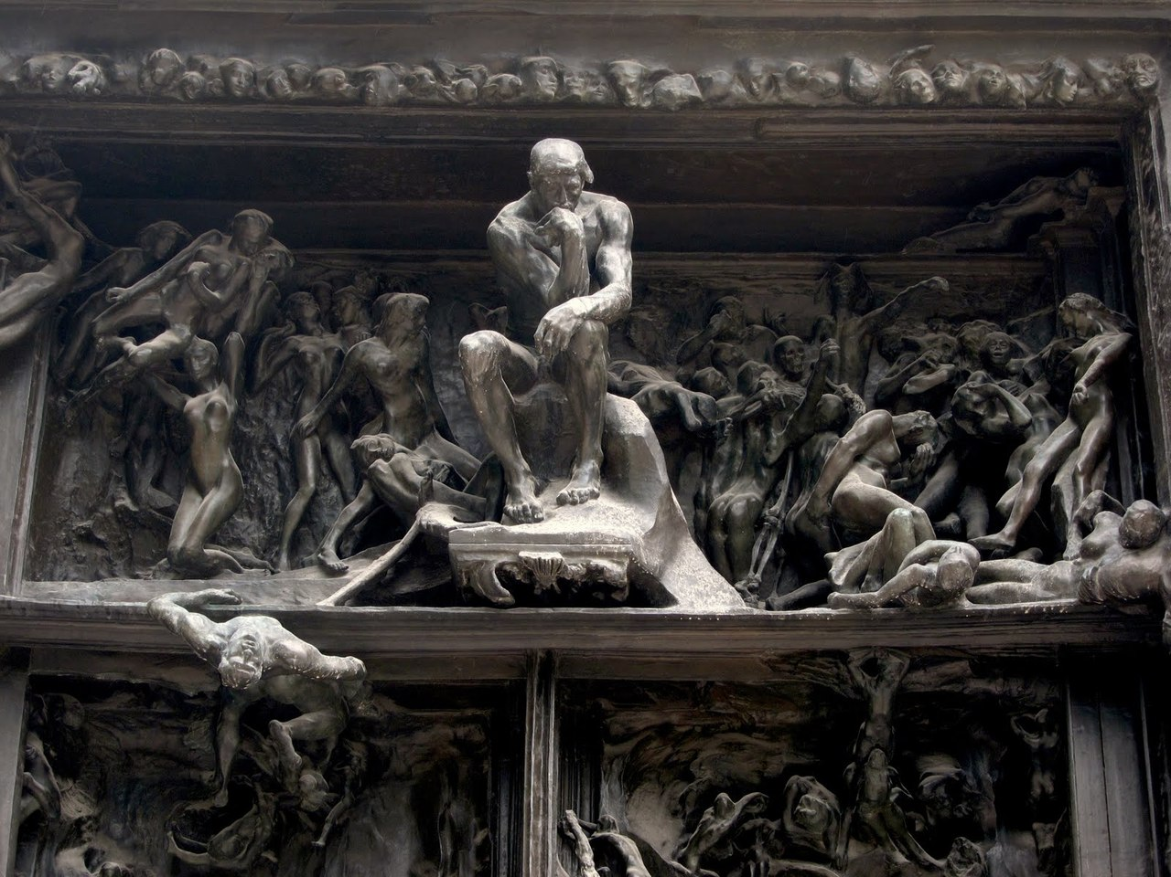

Slide 7
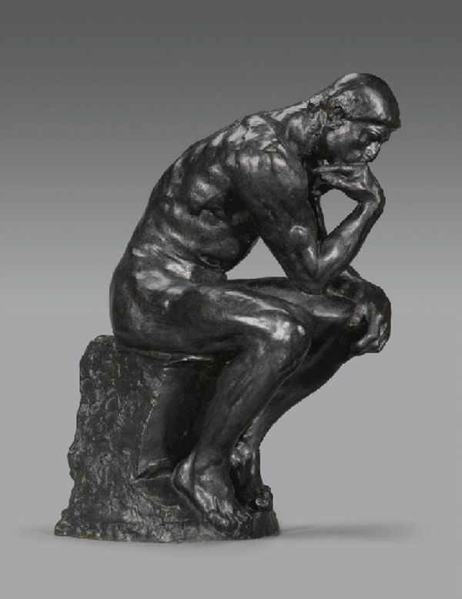
The Thinker
Figure from „The Gates of Hell“
Bronze
It obviously characterizes Dante, aspects
of the Biblical Adam, the mythological
Prometheus and Rodin

Slide 8
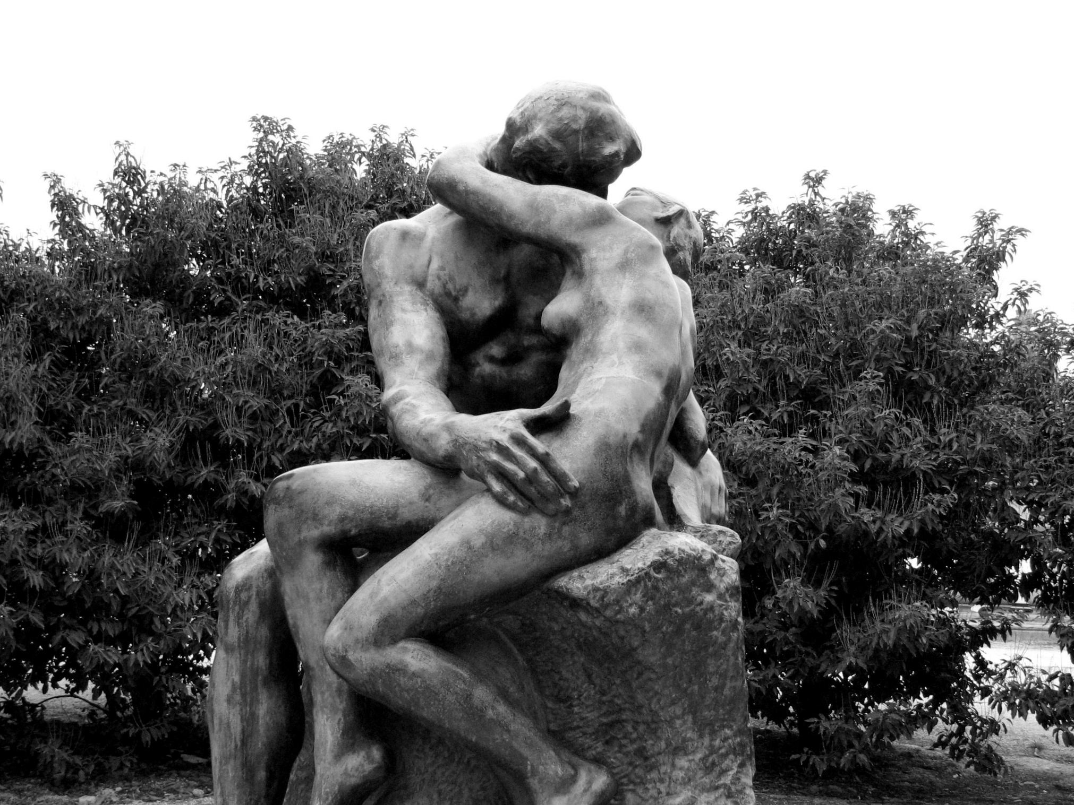
The Kiss
An inspiration was
Camille Claudel

Slide 9
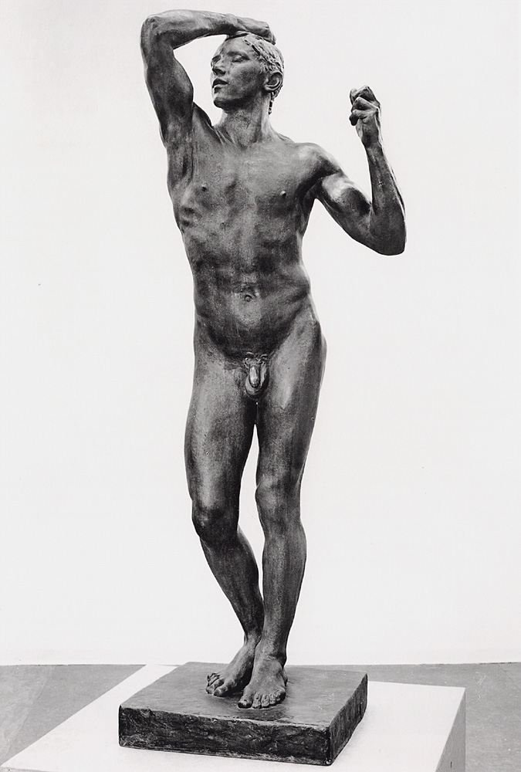
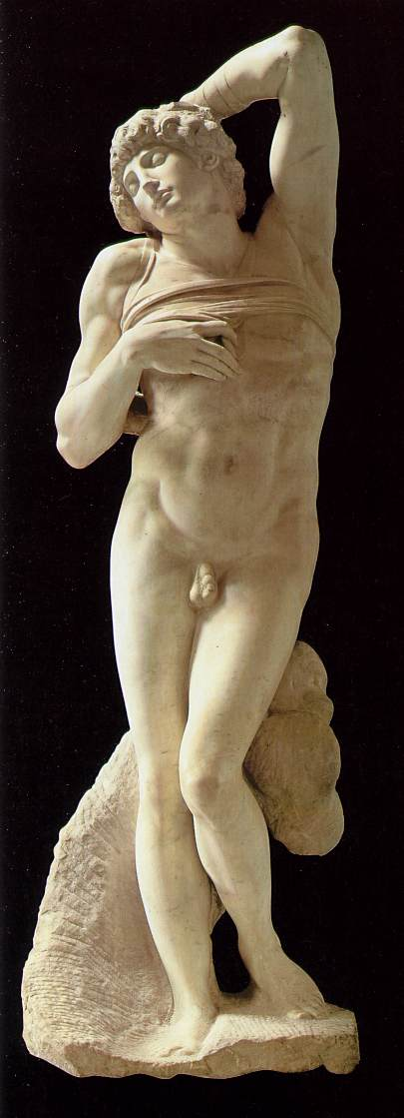
The Age of Bronze
An inspiration from Michelangelo's
Dying Slave
He was covninced from a deception
– making this statues by casting
a living model

Slide 10
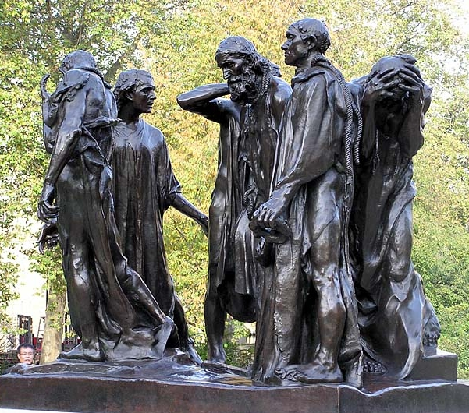
The Burghers of Calais
A monument of an occurrence
during the Hundred Years‘ War
(1347)

Slide 11
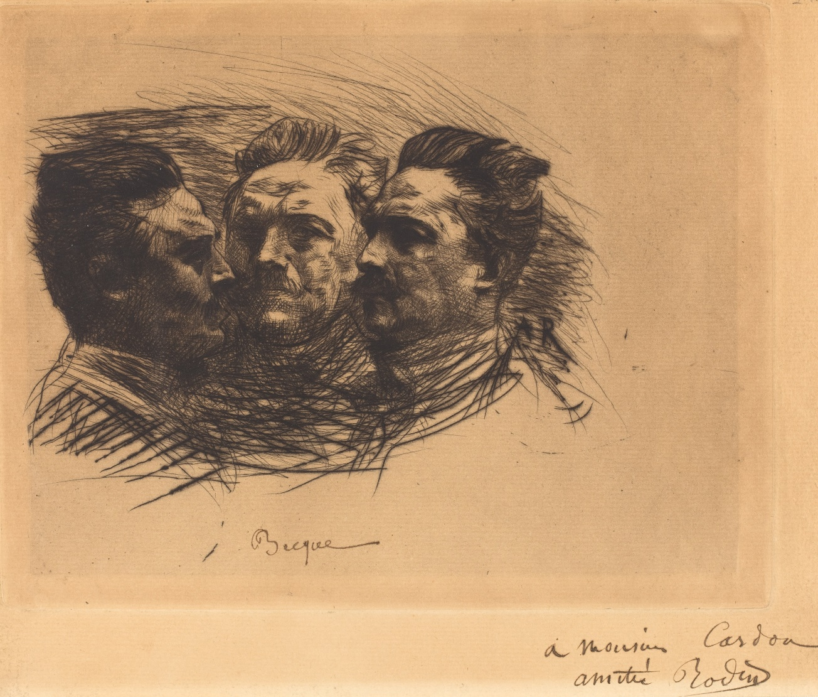
In his time, his art pieces were rejected
He also painted with oil paints,
watercolours, made pencil, chalk and
charcoal drawings, drypoints and
lithography (only one)

Slide 12
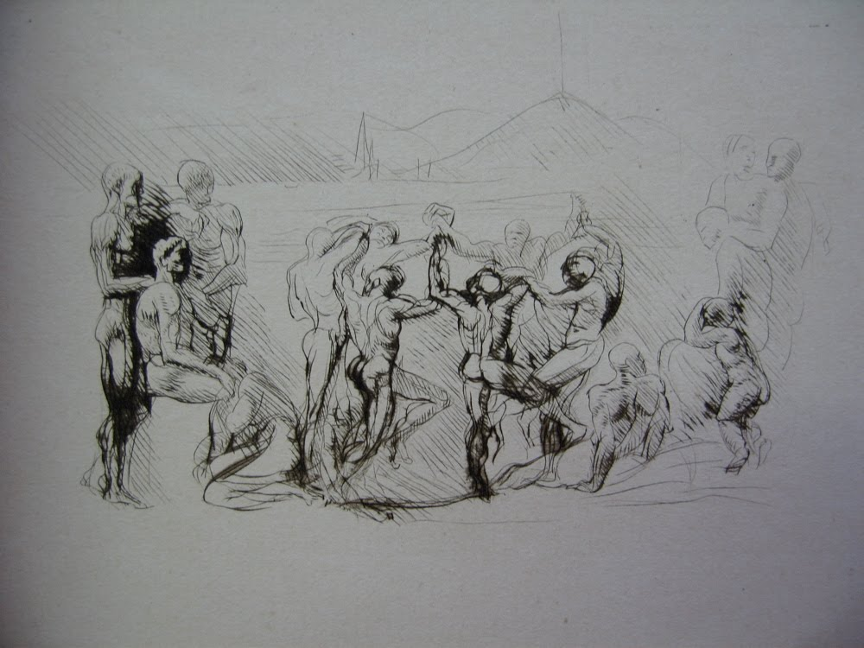
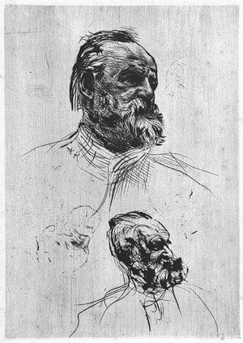

Slide 13
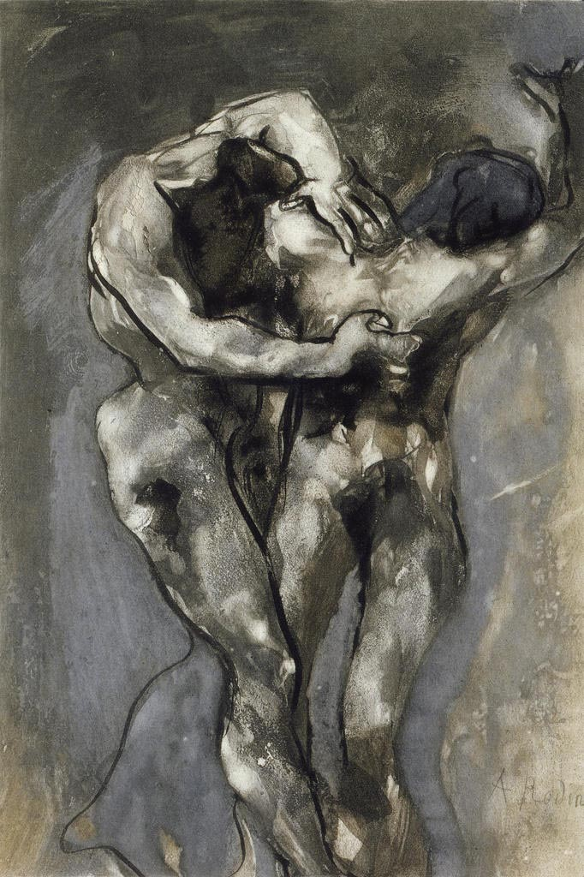
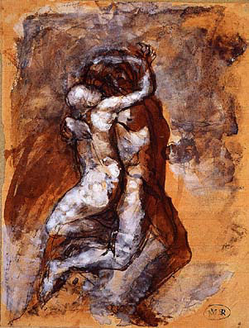

Slide 14
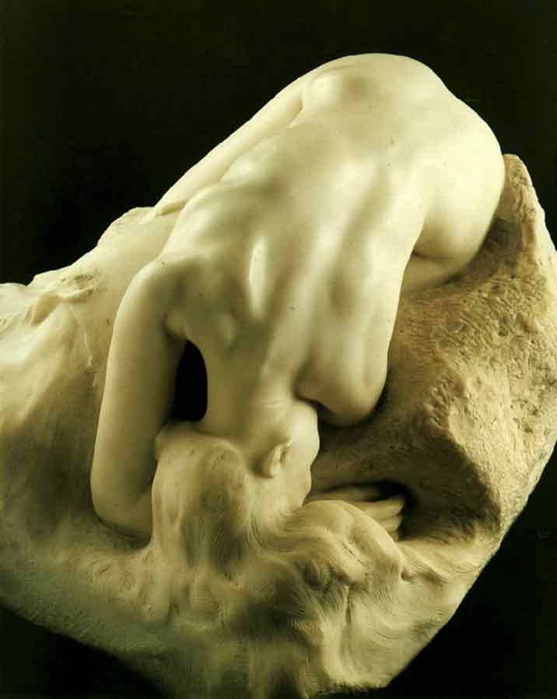
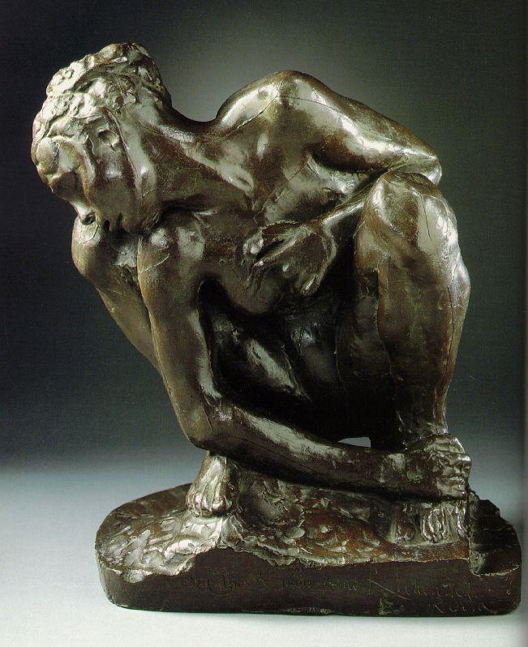

Slide 15
