Slide 1
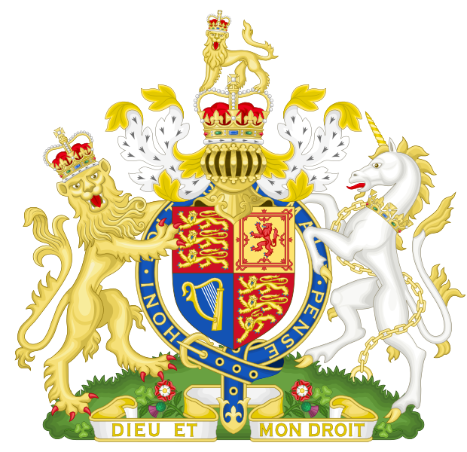
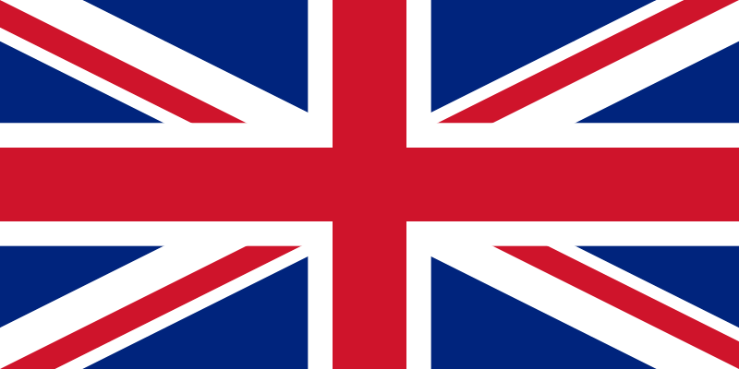
United Kingdom of Great Britain and Northern Ireland
Geography, climate, economy

Slide 2
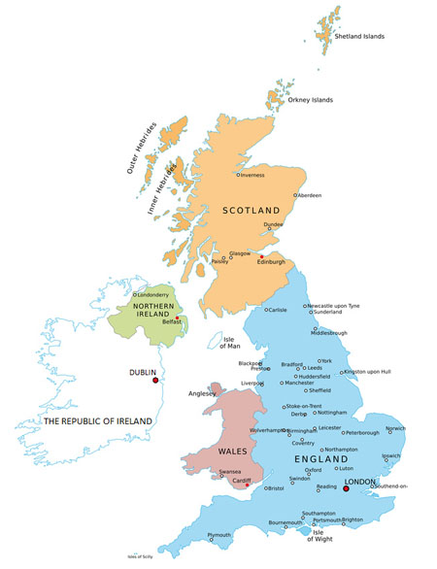
island state
devides 4 countries: England, Scotland, Wales, Northern Ireland
surrounded Atlantic ocean, Celtic sea, Irish sea

Slide 3
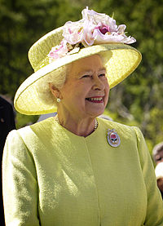
monarchy
queen: Elizabeth II.
curently: pound
languages: English
mild climate

Slide 4
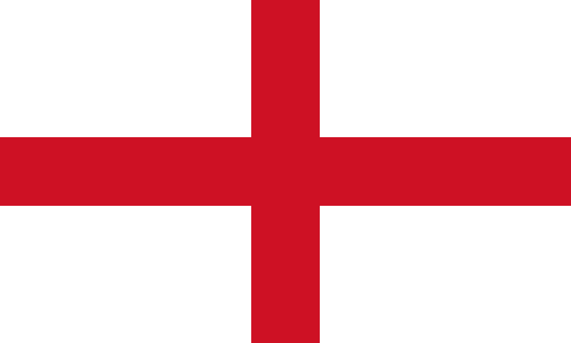
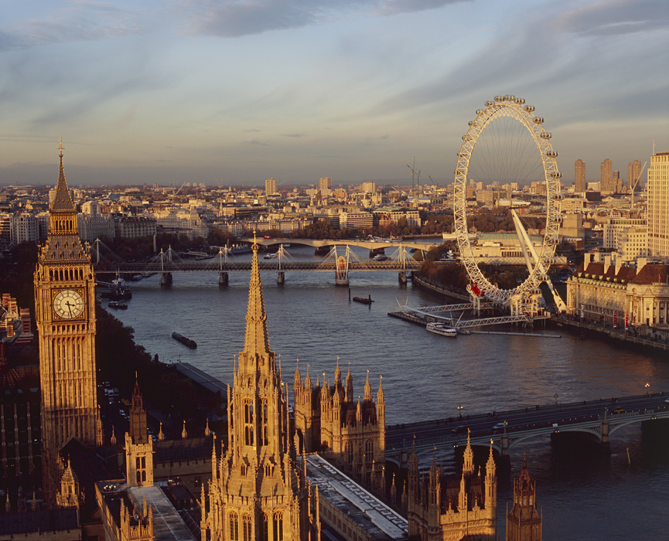
England
area: 130 395 km²
populations: 53 milion
capital city: London
other city: Manchester, Liverpool, Cambridge

Slide 5
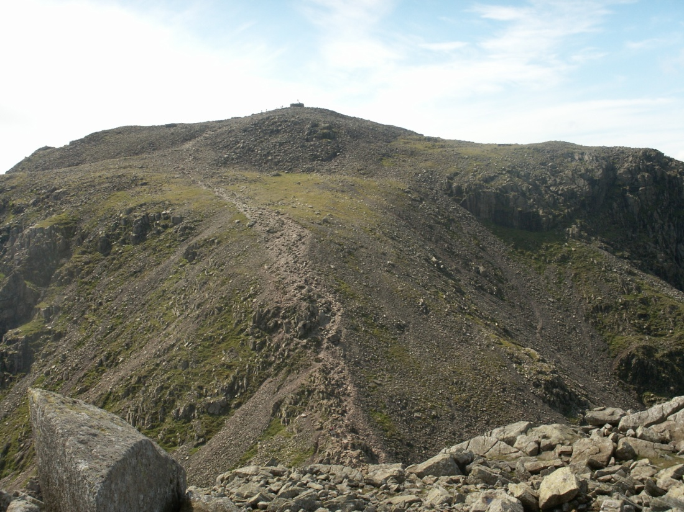
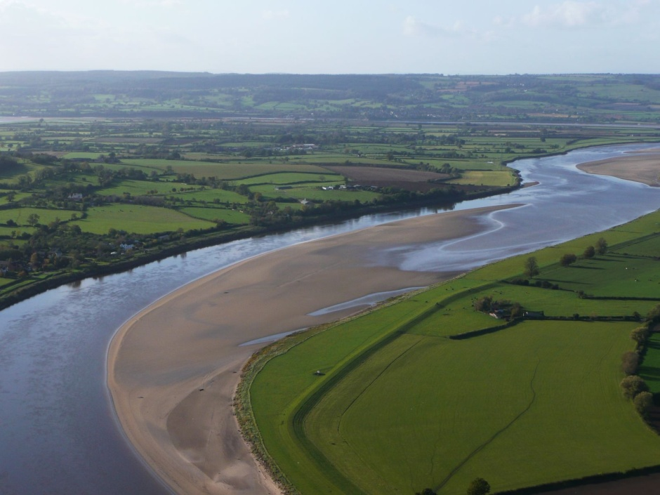
the highest point: Scafel Pike (912 m)
the longest river: Severn (354 km)

Slide 6
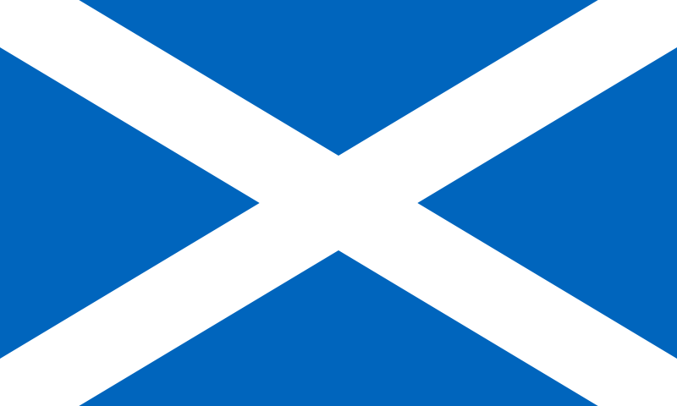
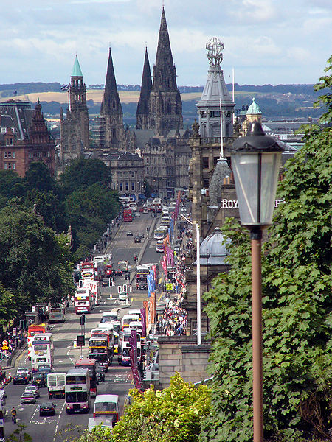
Scotland
area: 78 772 km²
population: 5 milion
capital city: Edinburgh
other city: Glasgow, Perth

Slide 7
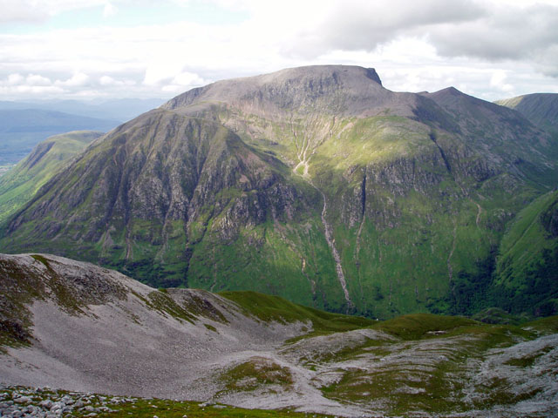
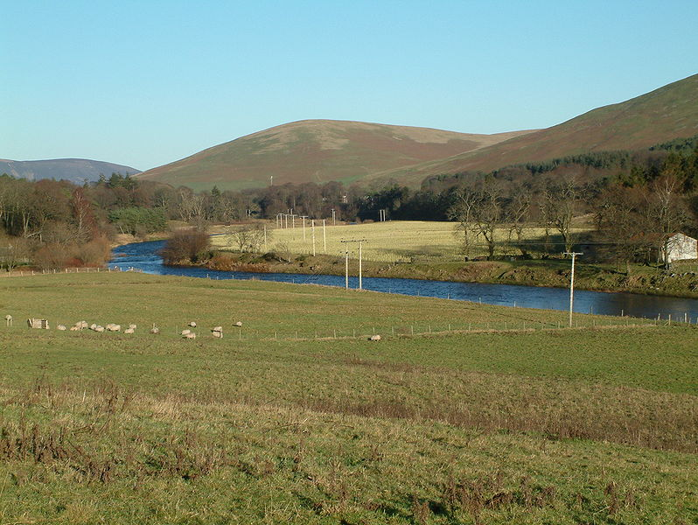
the highest point: Ben Nevis (1344 m)
the longest river: Clyde (170 km)

Slide 8
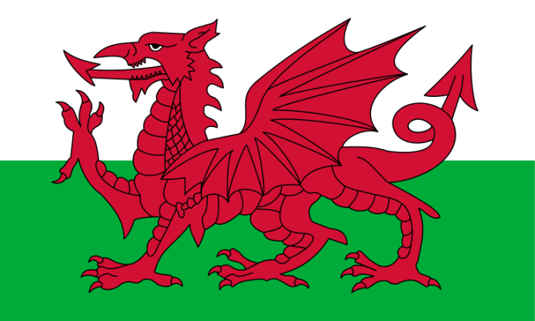
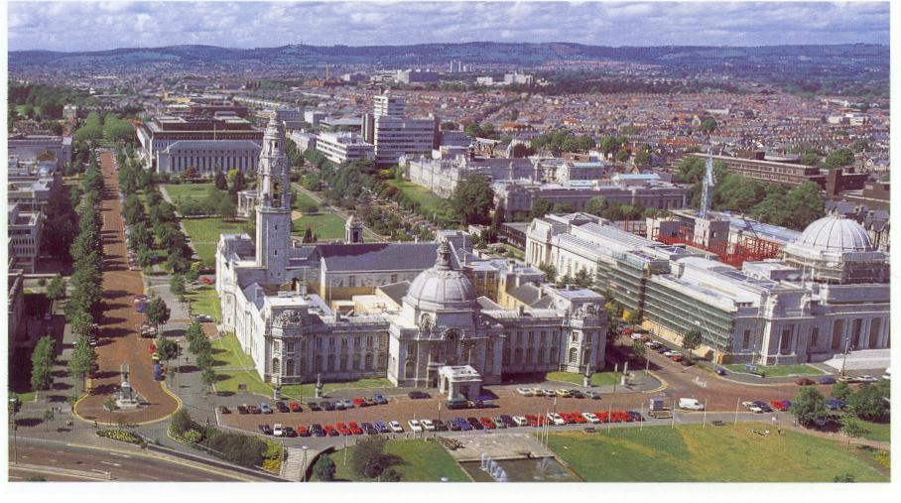
Wales
area: 20 779 km²
population: 2 milion
capital city: Cardiff
other city: Swansea, Newport

Slide 9
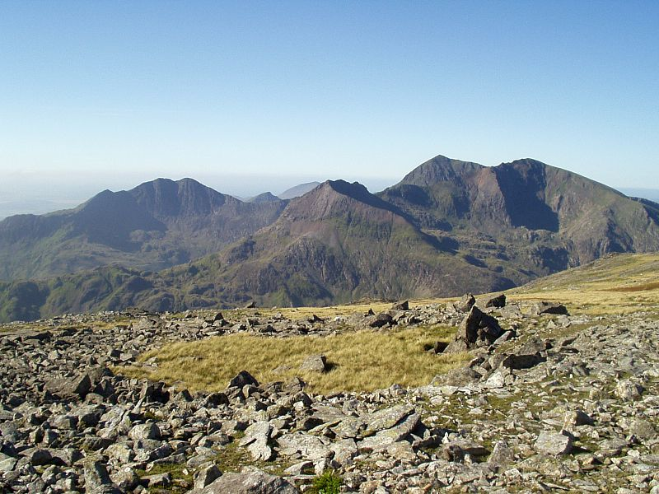
the highest point: Snowdown (1085 m)

Slide 10
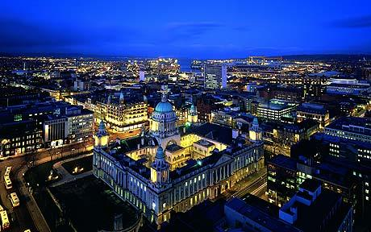
Northern Ireland
area: 13 843 km²
population: 2 milion
capital city: Belfast
other city: Armagh, Lisburn

Slide 11
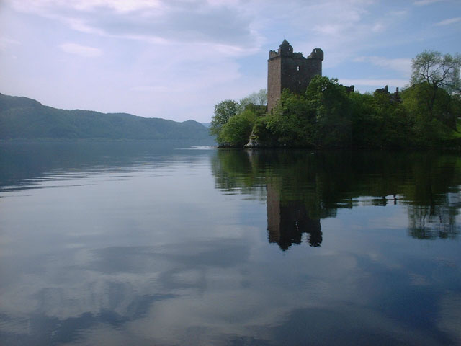
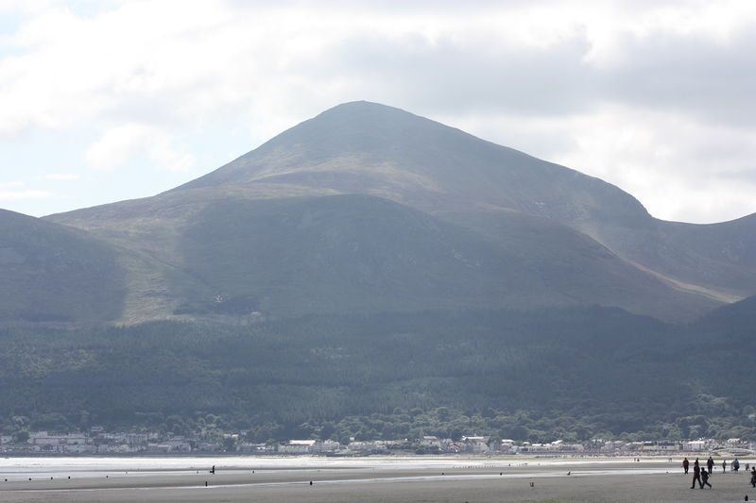
the highest point: Slieve Donart (852 m)
the biggest lake: Lough Neagh (382 km²)

