Slide 1
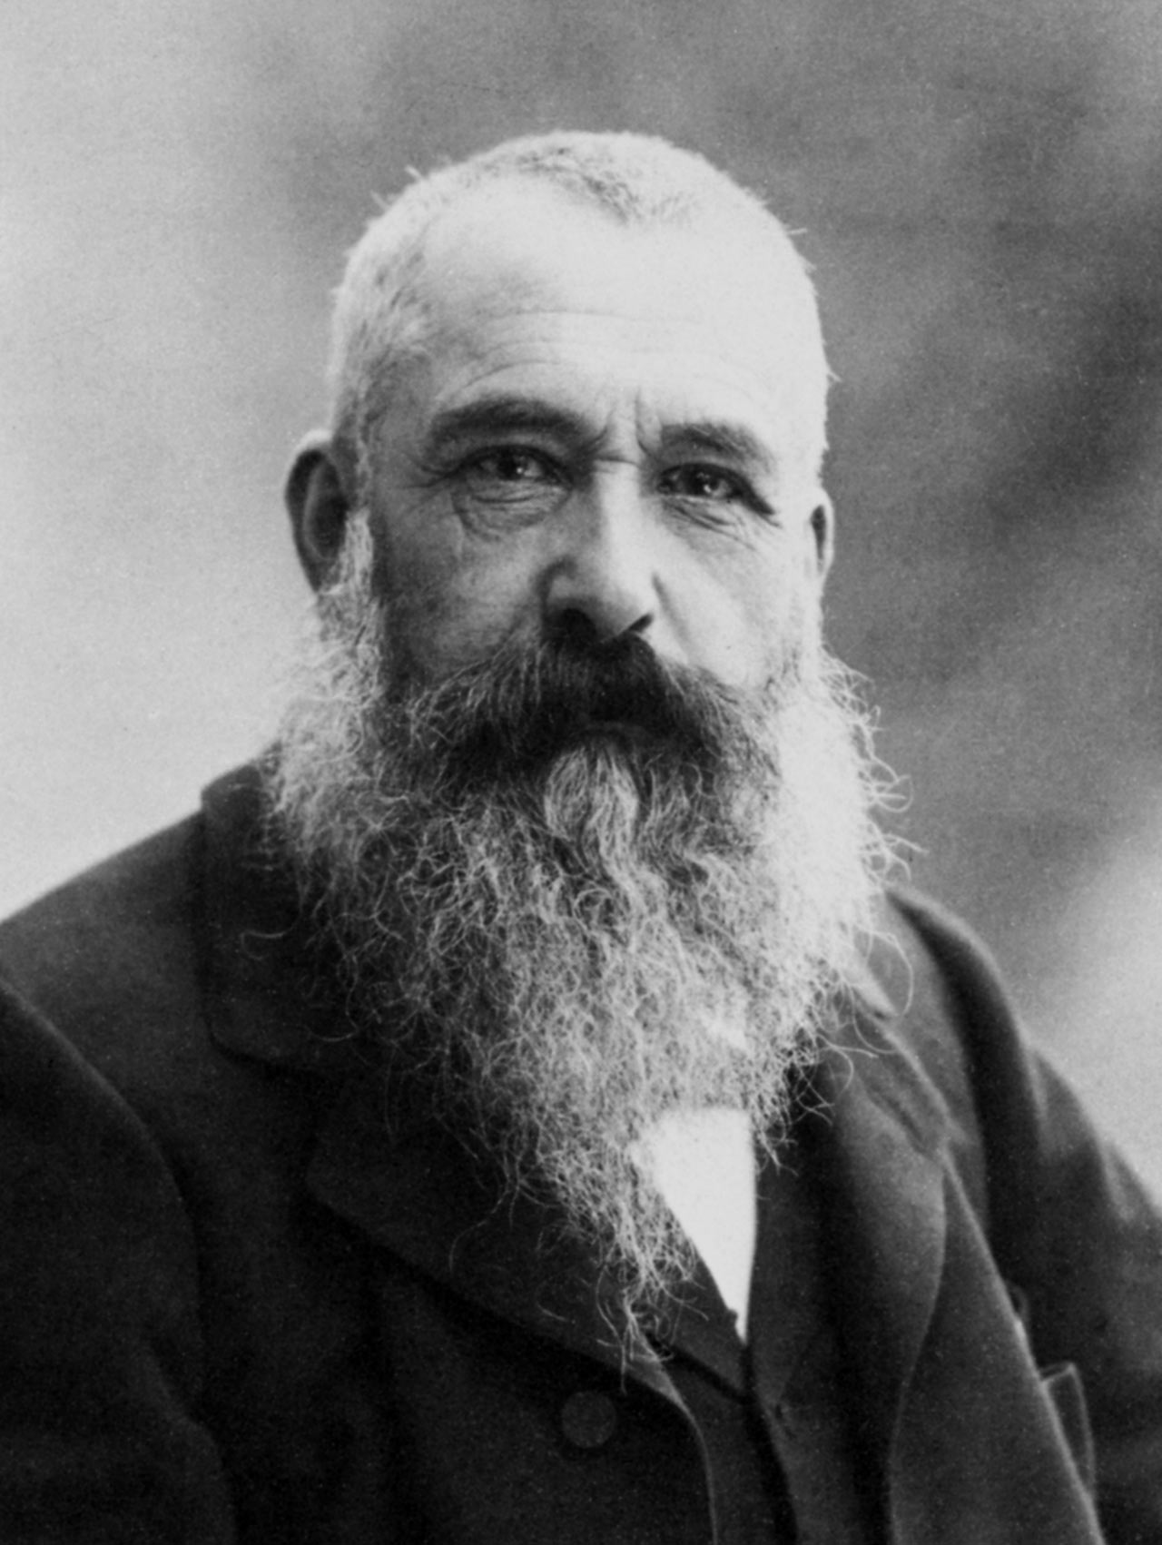
Claude Monet
*14th September 1840, Paris
† 5th December 1926, Giverny

Slide 2
Claude Monet
was one of the most famous artists of Impressionism (- style od art, that originated in the late 19th century)
was a French painter and printmaker
is the true father of Impressionism (-because of his painting)

Slide 3
Characteristics of Impressionism
capture the moment
painting without sharp contours
rapid brush strokes, stains
light effects in nature
paintings are full of bright colour – no dark tints
themes: nature, town, parks, dance halls

Slide 4
LIFE
As a child he lived with his parents in Normandy, in Le Havre (- it greatly influenced his work)
Even as a small boy drew cartoons on desks in a school (- it made him popular)
His first teacher was Eugene Boudin (- gained Monet for landscape painting)

Slide 5
Léon Marchon, a notary from Le Havre

Slide 6
LIFE
on the advice of Boudin, he went to Paris to study
enrolled in the Academy Suisse in Paris in the spring of 1859
he met Pissarro, Delacroix and Courbet at the academy (-his friends)
In 1862, Monet returned to Paris in the studio of Charles Gleyre (-he was very critical, Monet didn‘t like him)
He met Sisley, Bazill, Renoire

Slide 7
Start his own creation
In December 1863, his Master dissolve their school - Monet and his friends had to do their own work
They began to paint outdoors in nature – they painted in the open air - Barbizon School
figural composition in life-size – Breakfast in 1865

Slide 8
Breakfast 1865 -inspiration in Manet's work -society didn‘t accept it - he sold it

Slide 9
Start his own creation
first exhibition of paintings was held in 1874
showed his famous painting that started the career of a new artistic style - Impression, soleil levant - Impression, Sunrise

Slide 10
Impression, Sunrise

Slide 11
Impression, Sunrise
made by his strong impression of the rapidly changing landscape of the morning in the port of Le Havre
captures the immediate impression by the strokes and stains
reflections sea level, unfinished docks, movement of the waves and the morning sun - painted it this technique

Slide 12
Impression, Sunrise
At first, the society didn‘t accept this paiting
The magazin editor described the painter as "Impressionists" - the painters, who just paint impressions
Later, however, his paintings have become successful

Slide 13
The other works
One of the first paintings - His wife Camille, or The Lady in a green dress
- often painted her in figural paintings with his son

Slide 14
The other works
Rouen Cathedral
- painted when he traveled to France, the Netherlands and England

Slide 15
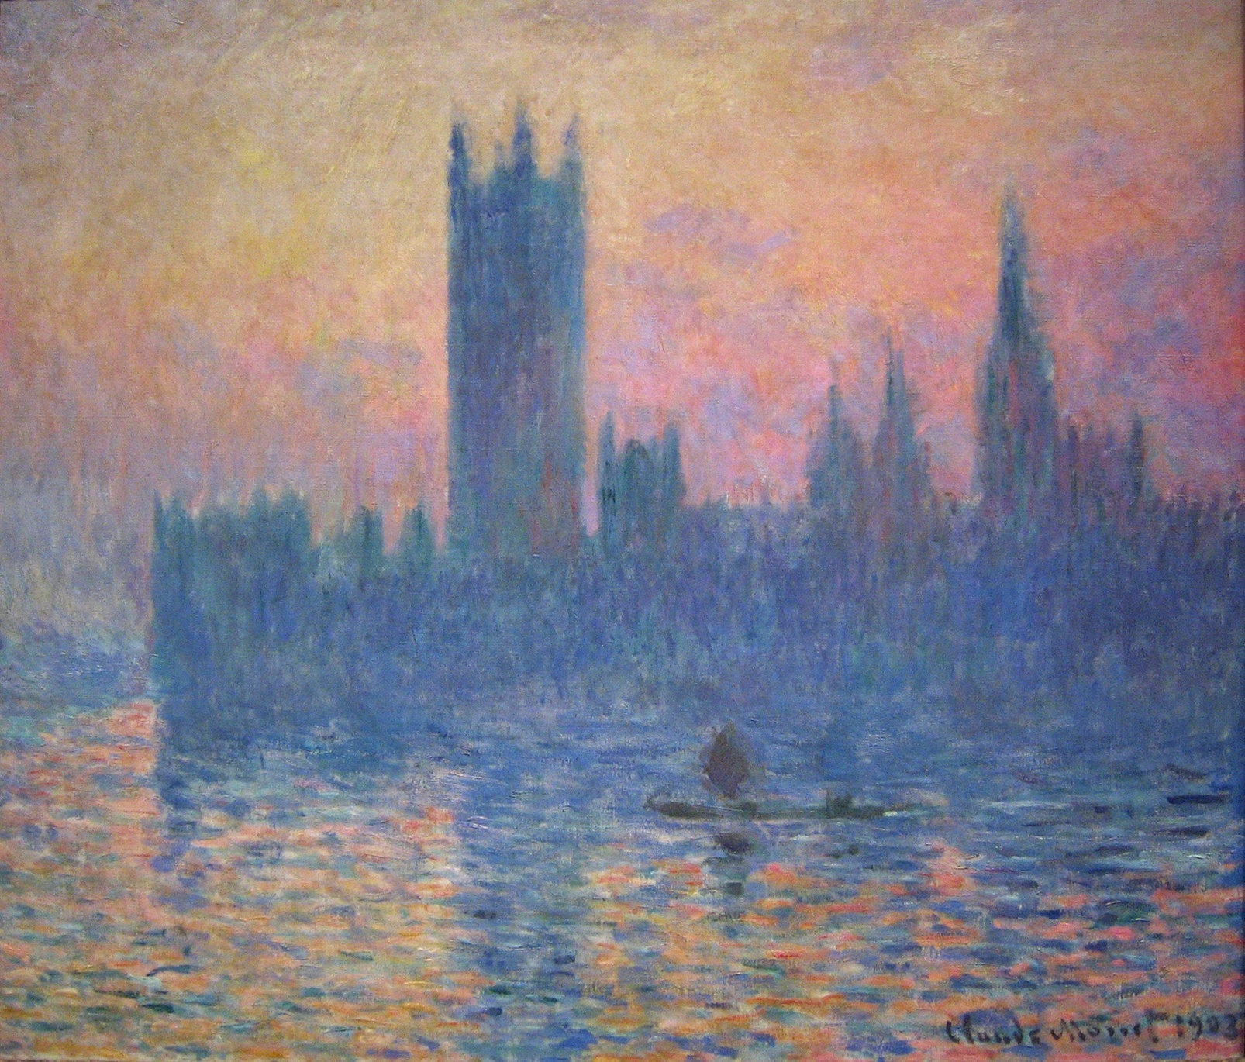
The other works
Parliament – London
painted on the banks of the River Thames

Slide 16
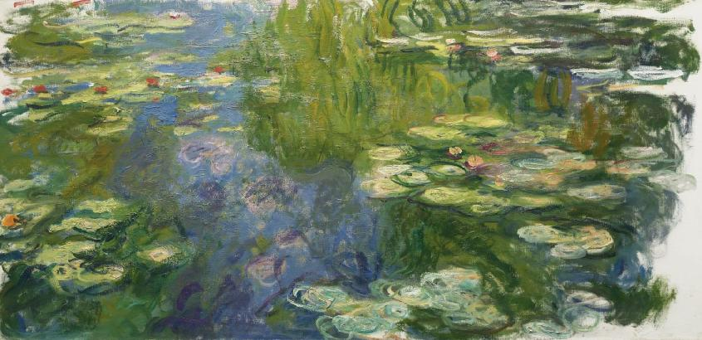
The other works
Water lilies in Monet's garden in Giverny
The garden looked more like a park
The paintings look like abstract colored surfaces

Slide 17
The other works

Slide 18
In 1922, after the 1st World War was already completely blind
Water lilies series devoted State

Slide 19
My opinion
I really love Monet‘s paintings and the Impressionism in general. I like the lightness and freedom of graphite and I really wanto to see Monet‘s paintings in real life, but I haven‘t had opportunity yet. I just have posters of Monet's paintings in my bedroom, but that's not the right experience.

Slide 20
The end of presentation
Thanks for watching.

