Slide 1
GUSTAV KLIMT ( 1862-1918 )
život, rodinu, díla, nejznámější dílo a vlastní názor

Slide 2
LIFE AND FAMILY
- Gustav was born on the 14th of July in Baumargten near the Vienna.
- his father Ernst Klimt was a goldsmith and his mother stayed home with him and his six other siblings.
-his father prepared his sons for the job of goldsmith but they seemed to have an artistic talent, especially Gustav. At age of 14 he succesfully passed through the entrance examination to Vienna school of arts and crafts.
- while he was studying in Vienna he lived in poverty than his brother Ernst started to study there,too.With this event began their cooperation.
- Klimt‘s lifelong mate was Emilia Floge , he never married her but they were happy together mainly because she tolerated his affairs with another women.
- Klimt had 14 children (most of them with different women) mainly with his models which were also prostitutes.

Slide 3
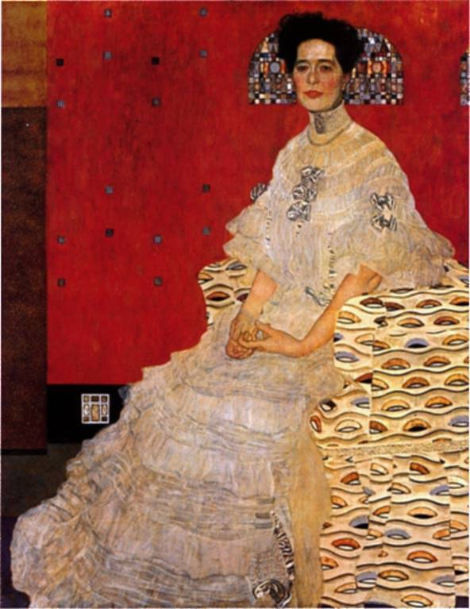
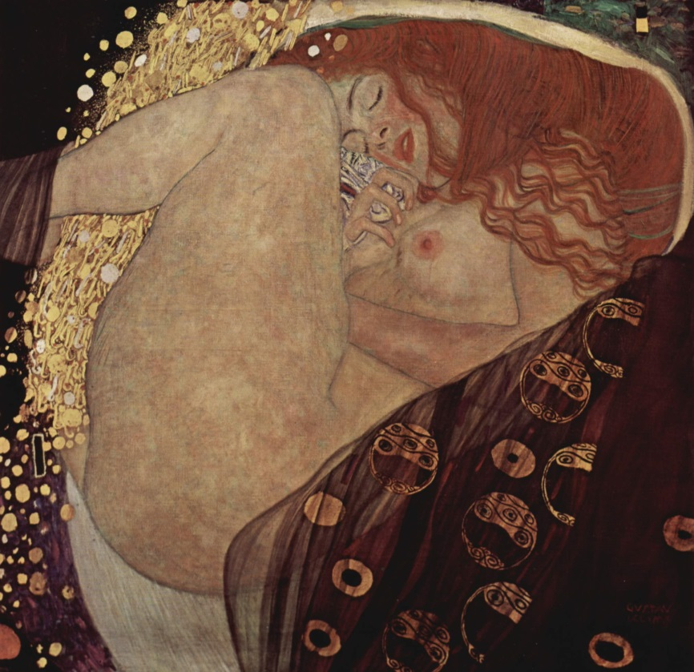
WORK
- his main motives were women (dressed like a godess or naked )

Slide 4
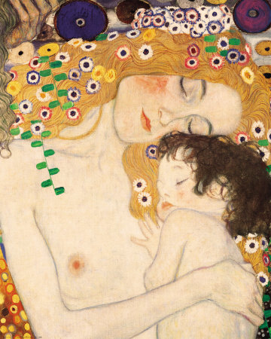
-in his century he was provocative and rebelious.
- he also painted a motherhood‘s themes.

Slide 5
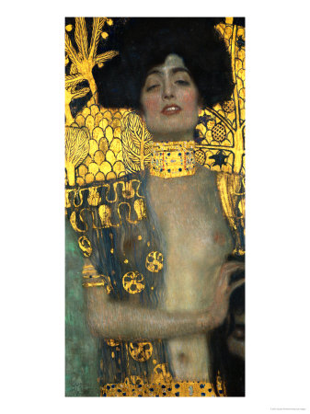
- Judith is concidered as his masterpiece
- he used to paint women as a strong and independent creatures

Slide 6
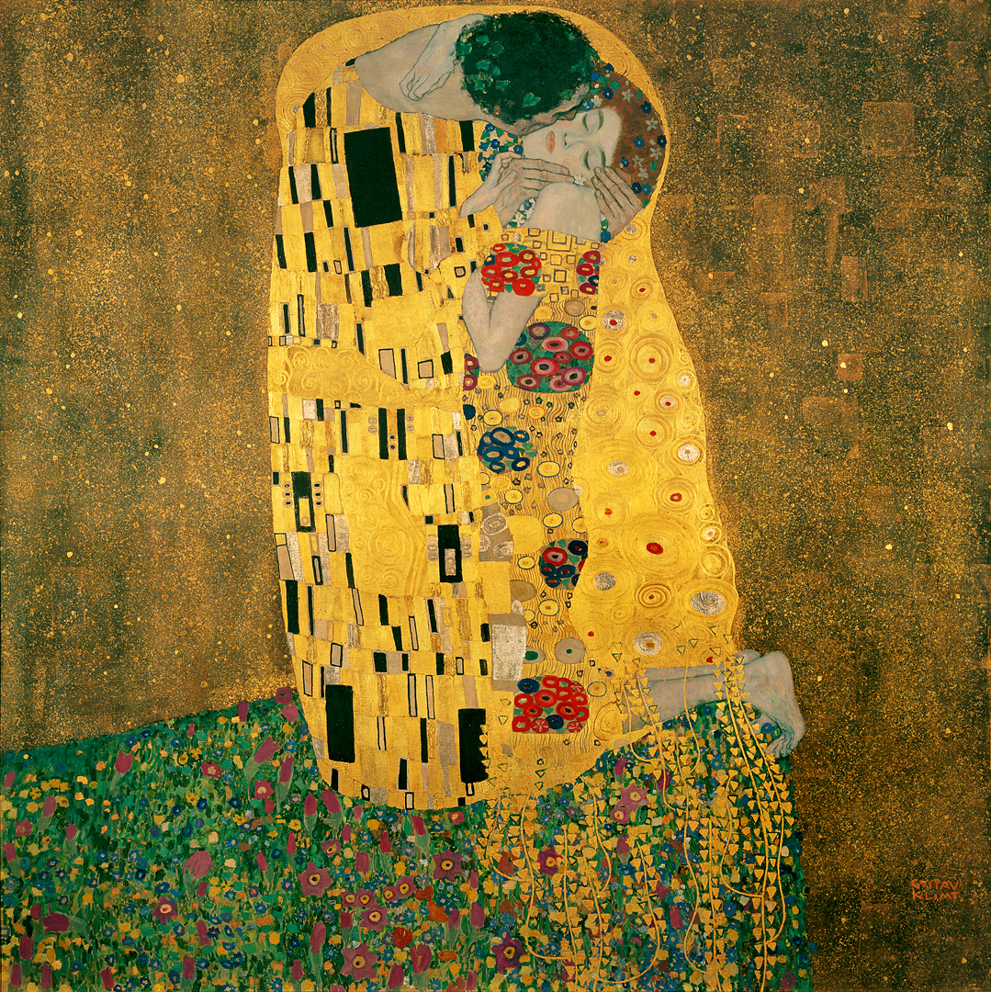
- his also very famous artpiece is ,,The Kiss“
-it symbolises eternity of love and youth

Slide 7
Adele – Bloch Bauer, which sold for a record $135 million in 2006, Neue Galerie, New York

Slide 8
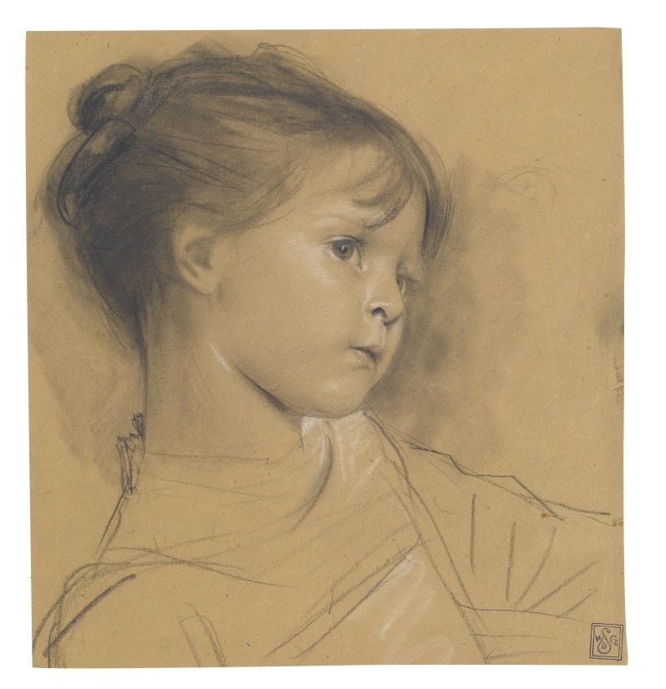
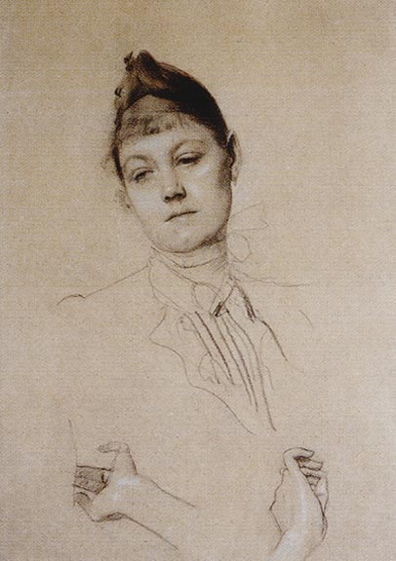
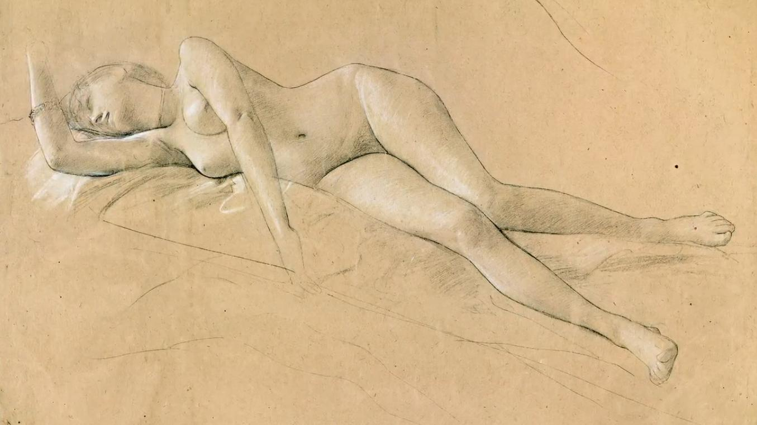
He was also a great drawer.

Slide 9
In my opinion.He was extraordinary painter and artist. In his personal life he was confused and very open to women. And.. I understand him..sort of.

